Slide 1
Trauma-Informed, Culturally Safe Approaches for the Animal Services Sector
Presented by Sareeta Lopez, Program Manager at the Vancouver Humane Society
Notes:
My name is Sareeta Lopez, my pronouns are she/her, and I am the Program Manager with VHS.
I’m really excited to be connecting with you all today, so thank you so much for taking the time to join in. In our workshop today we’re going to be talking about trauma-informed and culturally safe approaches for the animal services sector.
There will be breaks throughout but please also feel free to step away if you need to
Things to have: workbook, pens, water, snacks
Feel free to put questions into the chat or write them down as we go, to save for the end.

Slide 2
Land Honouring
I am grateful to currently be living on the unceded territories of the xʷməθkʷəy̓əm (Musqueam), sḵwx̱wú7mesh (Squamish) & sel̓íl̓witulh (Tsleil-Waututh) Nations.
We encourage you to learn more about the land you are living on by using the interactive map at https://native-land.ca/
Notes:
I would like to begin this module by acknowledging that I am grateful to currently be living on the unceded territories of the xʷməθkʷəy̓əm (Musqueam), sḵwx̱wú7mesh (Squamish) & sel̓íl̓witulh (Tsleil-Waututh) Nations.
We encourage you to learn more about the land you are living on by using the interactive map at https://native-land.ca/

Slide 3
Learning Objectives
Explain the importance of trauma-informed and culturally safe care and its impact on clients, staff, and animals in need of care.
Describe key principles and core components of trauma-informed, culturally safe care that are relevant within the animal services sector.
Identify the behavioral, emotional, and physical signs and symptoms of trauma in both yourself and others, enabling early recognition and appropriate responses.
Practice effective communication skills that allow you to interact sensitively and compassionately with trauma survivors, emphasizing active listening, empathy, and providing choices.
Implement practical strategies for creating safe and supportive environments for traumatized individuals and communities, considering physical, psychological, emotional, and cultural safety in the animal services sector.
Notes:
The aim of this workshop is that it helps you to become familiar with trauma-informed principles, cultural safety, and ways to promote personal and organizational resilience. This is an opportunity to think about the role you can play in supporting a safe environment for animals, guardians, coworkers, and of course for yourself.

Slide 4
Research Background
Key term: Placed-at-risk
Collectively refers to individuals and groups who are marginalized, recognizing that the vulnerabilities and risks are structurally rooted and often not within the control of the individual
Placed-at-risk populations include people experiencing pervasive poverty (poor nutrition, homelessness), people who use drugs, people experiencing mental health challenges, people who may be geographically isolated from services (rural or remote communities), and people dealing with current or past trauma (such as situations of domestic violence, intergenerational or cultural trauma)
Notes:
I want to share a bit about the background of this project and give you some context on where the recommendations we’ll discuss today came from.
So we launched the study for this project in 2020, and the idea behind the project was to explore how we can incorporate a more trauma-informed, culturally safe approach into animal service work, particularly when working with placed-at-risk folks in instances of animal neglect. This idea came from the understanding that people from all backgrounds enjoy the companionship and mental health benefits of animals, but people who are placed-at-risk—so that could be those experiencing poverty or systemic discrimination—are often at a higher risk of dealing with past traumas and current hardships, and in turn can face barriers in caring for their pets. To explore this, we interviewed 28 study participants across Canada, including: 11 workers in the animal services sector who had experience with surrender and/or seizure of animals; 9 workers in different sectors that already implement trauma-informed practices in their work; 8 people with lived experience of surrender and/or seizure of animals, or who had challenging experiences with an animal services organization. The report that we published based on this research discusses opportunities in the animal services sector to address these barriers. And now, we’ve turned that report into an online training program and virtual/in-person workshops.
So with that, I also wanted to note that the information I’ll be sharing today is rooted in the actual lived experiences of animal protection workers that were interviewed—including real-life scenarios they’ve been in and recommendations they highlighted. It also includes the experiences of workers in other helping sectors that use trauma-informed approaches as well. And this is because we wanted to ensure that the recommendations we give are practical and relatable. So I am essentially a vessel for that information!

Slide 5
Course Structure & Objectives
Notes:
The aim of this workshop is that it helps you to become familiar with trauma-informed principles, cultural safety, and ways to promote personal and organizational resilience. This is an opportunity to think about the role you can play in supporting a safe environment for animals, guardians, coworkers, and of course for yourself. As we move through this workshop, there will be opportunities for reflection where I’ll prompt you with a question and give you some time to write down your thoughts. There will also be a few activities and opportunities for discussion. You are of course not required to share out loud, but if you feel comfortable doing so, that’s great. The chat box is also available, so please feel free to share there as well when prompted to do so; note that the chat box is public and I will read responses out loud for accessibility.
Trigger warning
This course discusses some difficult topics. Acknowledging loss, trauma, or abuse of any kind is extremely difficult, and it can trigger a range of responses. If you feel triggered, upset, or confused about anything discussed during the training, we encourage you to seek support in a way that feels safe for you. Please feel free to take breaks throughout and do what feels best for you.

Slide 6
What is One Welfare?
One Welfare is a concept that describes how animals, people, and the environment are connected to each other. The well-being of one affects the others.
This concept is essentially the same as the Indigenous concept of All My Relations.
Notes:
So I want to start off by expanding on the terms I’ve mentioned so that we all have a shared understanding.
You may already be familiar with the concepts of trauma-informed practice, One Welfare, prevention and early intervention, and cultural safety. Or, you may have encountered these terms in other contexts.
First, let’s talk about One Welfare. One Welfare is a concept that describes how animals, people, and the environment are connected to each other. The well-being of one affects the others.
[switch slide] to show graphic

Slide 7
Credit: onewelfare.org
Notes:
If we understand that human and animal health and well-being are linked together, it follows that collaboration between human and animal professionals, and other community partners is necessary.

Slide 8
Reflection
Notes:
Before we move on, let’s do a quick reflection here and take a moment to think about examples from your own life or work where you see connections between people, animals, and the environment.
I’ll give you a couple minutes to think about that, and then I’ll bring us back and invite you to share either out loud or in the chat box. This is reflection 1 in your workbook so feel free to take notes there.
2 minutes, then 1 min for discussion.
Does anyone want to share?
[discuss]
If no one shares:
Reflection #1: people who put hummingbird feeders out, and then they come and like trill at humans
Reflection #2:
Reflection #3:

Slide 9
Notes:
That’s great, thank you. I also wanted to share this image that was shared in a webinar called Resource or Relation? Indigenous perspectives on animals with Dr. Jesse Popp. This is an image Dr. Popp shared to demonstrate the ego vs. eco concept, and interconnectedness as a part of Indigenous worldviews. So as you can see the idea is to view animals and the environment and humans as connected and related rather than one being more important than the other. So Dr. Popp explained that the idea is to view these interconnections holistically rather than in a reductionist sense.

Slide 10
Why is One Welfare important?
More support for animal guardians, their pets, and organizations through collaboration with other professionals, social services, and community partners.
Thinking about issues that exist in the animal services sector through a ‘One Welfare’ lens means more collaboration with:
mental health professionals
veterinary clinics
animal behaviour professionals
homeless shelters & temporary housing
Indigenous communities, bands, Chiefs and Councils, and friendship centres
emergency departments
other social service organizations
Notes:
So why should we implement a One Welfare lens in our work? We can better support animal guardians and their pets, as well as ourselves as workers, if we get creative about addressing issues.
By this I mean collaborating with other professionals, social services, and community partners. The reflection we just did is a great example of this.
Thinking about issues that exist in the animal services sector through a ‘One Welfare’ lens means more collaboration with:
mental health professionals
veterinary clinics
animal behaviour professionals
homeless shelters & temporary housing
Indigenous communities, bands, Chiefs and Councils, and friendship centres
emergency departments
other social service organizations
maybe even banks – people leaving domestic violence

Slide 11
Activity: Systems Mapping
Create a 'systems map' by thinking about some of the people, agencies, and services you connect with in your work. Then, you can add in some connections that you know exist in your community that you would like to work with. Some questions to think about:
What other services exist in your community that might be even distantly connected with the people and animals you work with?
What potential is there for collaboration?
If you are new to the area/community, what is your knowledge of local resources, and who could you collaborate with to help identify resources?
Notes:
Of course, the makeup of your community also influences who you collaborate with. So I want to invite you all to participate in our first activity, where we’ll create a systems map. You may have seen this before—a systems map is essentially a list of components of a system or environment. So please take a moment to jot down a 'systems map' of some of the people, agencies, and services you connect with in your work. Then, you can add in some services/agencies/people that you know exist in your community but maybe you haven’t connected with but would like to.
This is Activity 1 in your workbook. Some questions to think about: What other services exist in your community that might be even distantly connected with the people and animals you work with? What potential is there for collaboration? If you are new to the area/community, what is your knowledge of local resources, and who could you collaborate with to help identify resources?
[switch slide to show photo example]

Slide 12
Systems Map Example
Notes:
[discuss]
Ideas: groomers, food banks, working with prisons, students to help them get volunteer experience

Slide 13
Early Intervention & Prevention
Early intervention and prevention means that we are identifying and providing effective support to people and communities before an emergency or an issue presents itself.
Outreach-based practices are the ways we can engage in early intervention and prevention practices, for example, by setting up a booth at a community event and sharing information about the low-cost spay and neuter services an organization offers, and why this is important.
Notes:
So I want to mention intervention and prevention-based approaches here, because these types of approaches are connected to a One Welfare approach, and to the activity we just did about potential collaborations. Early intervention and prevention means that we are identifying and providing effective support to people and communities before an emergency or an issue presents itself. These approaches are relevant to the concept of One Welfare because they focus on collaboration between sectors to better provide services, and on the connectedness of animal and human well-being.
Outreach-based practices are the ways we can engage in early intervention and prevention practices, for example, by setting up a booth at a community event and sharing information about the low-cost spay and neuter services an organization offers, and why this is important.
We'll reflect back on this later on this workshop, and you'll have the opportunity to reflect on these approaches while keeping trauma-informed and culturally safe practices in mind.

Slide 14
Now? How?
Remember your why.
Choose less, but better.
Solve the problem at its root.
Notes:
It's great that many organizations are already implementing these practices, because we can learn from them.
I also want to acknowledge that animal service workers and organizations are overwhelmed.
But if anything, that's proof that the way we've been doing things has not been working, it's not effective.
So, while it will take time and work to get these things up and running, it's actually going to save you time in the long run. It may not feel like it's working right away, but over time, you will see a return on your investment.
I want to invite you now to remember your why. No need to share, just think about it, take a breath. Be still.
You are all working in this sector for a reason. We all know the importance of treating the earth better and animals better. The reality is the earth is basically screaming at us that we have run out of time. So the work you’re doing is critical. It’s more important than ever. And for you to get that incredible work done, we need to switch gears, collaborate, and act quickly.
This moment, where we are in a pandemic, the world, the political climate, the actual climate, is a window of opportunity, even with this also being the moment that the animal sector is overwhelmed, and its humans and resources exhausted.
The burnout and overwhelm is a result of the system breaking down under pressure from the pandemic. Burnout is also an indicator that something isn’t working; personally for you in your life and on a larger systemic scale. So what does the state of things tell us? The way that things worked may have worked in the past, but much like one scales a business at it grows, it’s up to leaders and organizations like yours to scale the way you work, as the work itself becomes more and more important.
Since you will have to change how you work, it will feel like a lot of work up front. This is the moment where we can say yes, and/but/also. Yes, we need to care for ourselves and take as much off our plate as we can right now. But/and/also, this needs to be a top priority. Choose less, but better. Take breaks. Plan ahead. Work together.
As you implement this training it will solve the problems at the root. Doing that is much more effective than trying to return to “normal” … because the pandemic changed everything, by revealing that normal wasn’t working. So we need to adapt, and we need to do it fast.
So, what next?

Slide 15
What is Trauma-Informed Practice (TIP)?
A trauma-informed service provider, system or organization does the following:
They realize the widespread impact of trauma and understand potential ways for healing
They recognize the signs and symptoms of trauma in staff, people accessing animal services, others involved in the system
They respond by incorporating knowledge about trauma into policies, procedures, and practices
Klinic Community Health Care Centre, 2013
Notes:
Okay, so we’ve established a couple of the concepts that are all connected to a trauma-informed approach and they are work in conjunction with each other. I wanted to begin with these because they are aligned with trauma-informed organizational change. So now, let’s dive into what it actually means to take on a trauma-informed approach. I first wanted to ask, has anyone heard of a trauma-informed approach before? You can type yes in the chat, or click the thumbs up icon. Does anyone want to share what it means, or what they think it might mean?
Great, thanks for sharing.
So Klinic Community Health Care Centre explains that a trauma-informed service provider, system or organization does the following:
They realize the widespread impact of trauma and understand potential ways for healing
They recognize the signs and symptoms of trauma in staff, people accessing animal services, others involved in the system
They respond by incorporating knowledge about trauma into policies, procedures, and practices
On the personal level, we’re essentially embodying these values into our own work and interactions. We have an understanding of the prevalence of trauma, we understand how trauma can show up for a person, and we aim to base our actions and reactions on these understandings. So as an individual, we’re trying to embody values of a trauma-informed approach such as compassion, authenticity, collaboration, and safety. We’ll talk more in depth about these values later on.
Trauma and re-traumatization can occur for both workers and people requiring assistance from animal services. So among other benefits, an update to service delivery models will improve the well-being of workers and people accessing services, and promote the long-term care, safety, and protection of animals.

Slide 16
What is Trauma?
Trauma can be defined as an experience that overwhelms an individual’s capacity to cope. Traumatic experiences can affect one’s sense of safety, self-efficacy, and ability to regulate emotions and navigate relationships. It is also common for those who have experience trauma to feel fear, shame, helplessness, and powerlessness.
Canadian Centre on Substance Use and Addiction, 2014
Notes:
In order to really understand a trauma-informed approach, it’s important to understand what trauma means. I want to ask again, does anyone have a definition or understanding of ‘trauma’ that they’d like to share?
According to the Canadian Centre on Substance Use and Addiction, trauma can be defined as an experience that overwhelms an individual’s capacity to cope. Traumatic experiences can affect one’s sense of safety, self-efficacy, and ability to regulate emotions and navigate relationships. It is also common for those who have experience trauma to feel fear, shame, helplessness, and powerlessness.
Whether it is something that happened yesterday, a month ago, or during childhood, trauma is much more common than we think. Anyone can experience trauma, but those who have intersecting and compounding marginalized components of their identity may be more likely to experience adverse and traumatic events. Because of this, we have to be careful to also consider how social disadvantages and systemic inequities can impact different individuals and groups, and that can contribute to and inform traumatic experiences.
Now, I want to emphasize that you don’t have to be a psychologist or a trauma expert, and you don’t even have to know what the specific trauma is to employ trauma-informed practices. In fact, everyone benefits from trauma-informed practices, whether a person has a history of trauma or not. When we look at the world through trauma-informed lenses, we avoid labelling people as resistant, or uncooperative. Instead, we see how they may be affected by their life events, stress, and trauma, and we can more clearly understand the systems that have, and continue to, place them at risk.

Slide 17
What is the connection between TIP & animal protection work?
Benefits for animals & their guardians
Guardian feels better supported, safer, and more open to learning about resources that benefit the animals in their care
More likely to take advice and instruction about the needs and well-being of the animal in their care
Opportunity to improve living conditions for animals
More likely to reach out for/accept help before a situation becomes harmful for the animals
Benefits for workers & organizations
Less stressful interaction for all involved
Minimizes challenging situations
Seeing positive outcomes for guardian/animal = less burnout and compassion fatigue
Notes:
I hope that you’re starting to see the benefits of a trauma-informed approach. I want to share a bit about why a trauma-informed, culturally safe approach is important and relevant to the animal protection sector in particular. So why is this worthwhile?
First, let’s talk about why this is important for animals and their guardians. Implementing trauma-informed practices is not only beneficial for guardians, but for the animals in their care as well. Because of the nature of a trauma-informed approach, a person who has access to trauma-informed services is likely to feel better supported, safer, and more open to learning about resources that benefit the animals in their care. Also, a person is more likely to take advice and instruction about the needs and well-being of the animal in their care if the service interaction is positive and non-judgmental. The compassion, understanding, and communication inherent in trauma-informed practice creates a pathway to open communication. So its possible that people who have experienced trauma-informed care from an organization may be more likely to reach out for or accept help before a situation becomes harmful for the animals in the event that they face challenges in the future.
Trauma-informed/culturally safe practices are also really beneficial for workers and organizations. We all know that working in the animal services sector means you’re exposed to trauma and suffering on a regular basis. You’re dealing with burnout, with compassion fatigue, and you’re trying to support not only yourself but your colleagues too. The idea/goal is that the result is a favourable experience for all involved—we’re mitigating a negative experience and using trauma-informed approaches to hopefully have a more positive experience, resulting in a less stressful interaction for you, a less traumatic experience for them, and more positive outcomes for the animal involved.

Slide 18
Principles of a Trauma-Informed Approach
Notes:
So I hope we have a shared foundational understanding of these concepts at this point, and we can start moving into the principles of a trauma-informed approach and what these can look like in practice. I wanted to check in quickly and ask if anyone has any questions before we move on?
We can rely on a few trauma-informed principles to guide our behaviour, both in our work and in our relationships. We have identified those principles that are most relevant for animal services organizations. Many of these best practices and recommendations overlap with each other—they are interconnected and work in concert. So let's go through these one by one and talk a bit about them.

Slide 19
Understanding Triggers
Notes:
The first is developing an understanding of triggers. Triggers are related to trauma. A trigger is something that raises a memory of trauma or transports a person in their mind back to the original traumatic event. A trigger can be anything—a smell, a phrase, a sound, an interaction, clothing design, or physical body posture—and so can be present in any situation. Trauma responses are activated when a trigger happens. This looks different for everyone, but could show up as anxiety, anger, panic, or completely shutting down and not communicating. The person will most often not communicate or even be aware that they are being triggered by an element of a situation.
The reason for this is that when the body is activated into fight/flight/freeze (and a few others, but we won't get into that right now) -- blood flow is actually pulled from the part of the brain that manages communication and language, the pre-frontal cortex. The prefrontal cortext helps us with executive functions, like planning, decision making, short-term memory, speech, future consequences, and social "control." Blood flow is pulled from there and sent to the amygdala, which manages emotional responses like fear, anxiety, and aggression. It also processes memory and decision making.
But imagine that you lose executive function, your body is scared, and is ready to act based on emotional responses. Your memory and decision making are now primarily controlled by your emotions. The kicker here is that studies show that emotional arousal is directly related to the strength of the memory.
So when something is particularly emotional for you, you remember it more clearly.
Think about that: if someone is activated, losing executive function, emotionally fearful, anxious, or aggressive, and the animal services worker cannot identify that the individual is triggered, we may actually act in a way that cements in the individual's mind that they must distrust the animal service organization.
But being able to identify this, knowing the reason is that the individual's brain is literally concerned about life or death, even though they might be safe, gives us the context we need to support the individual.
This means that we should try to see any reaction through a trauma-informed lens, with understanding and compassion. For example, people who have been placed-at-risk may have trauma related to past and recent experiences with authoritative people or agencies which resulted in a mistrust of authority. This might result in flashbacks or memories surfacing based on the uniform or way the staff person is standing/talking, which in turn will shape their interactions with you.
So how do we manage this?

Slide 20
Signs an Individual is Activated
Struggling to speak, stumbling over words, or not speaking at all
Appearing on edge – glancing around, looking down, avoiding eye contact
Body appears tense or trembling, hands shaking
Pale or flushed skin
Breathing rapidly
Increased sweating
Dilated pupils
It takes 20 to 30 minutes for the body to return to normal and calm down.
Notes:
Less observable include increased blood pressure, heart rate, blunt pain response is compromised, and memories of the event are either very vivid and clear or blacked out. Sometimes the bladder is affected and releases.
It can take 20-30 minutes for the body to return to normal + calm, and remember that many people accessing services are living in a chronic state of stress and activation. That can take months, even years to recover from, meaning these individuals are much more easily activated even once they find safety.
Sources: https://www.health.harvard.edu/staying-healthy/understanding-the-stress-response https://health.clevelandclinic.org/what-happens-to-your-body-during-the-fight-or-flight-response

Slide 21
How To Implement Your Understanding of Triggers
Attend to immediate needs to help alleviate triggers
Food, water, clothing, housing, transportation – share resources, offer snacks, hot water/coffee, offer to call a cab if your organization has funds
Be transparent, consistent, and predictable as possible
Offer translation services – seek out volunteers
Allow a support person to be present if the individual feels that would be helpful, like a veterinary social worker or volunteer counsellor — start with volunteers
If a promise is made (to make a referral, or follow up with a phone call) follow through in a timely manner
Acknowledge and take responsibility for miscommunication
Clearly outline expectations
Obtain informed consent
Ask the individual to share their understanding of what’s been said

Slide 22
Using Accessible & Non-Triggering Language
Notes:
One of the first things we can do to mitigate a situation is using accessible and non-triggering language, in a soft tone of voice. This is closely tied to having an understanding of triggers. This is because of three reasons: 1) as we discussed, a person who carries trauma may have certain words that trigger a trauma reaction, 2) accessible and understandable language helps to eliminate power imbalances that often exist in service relationships, and 3) being triggered can often lead to negative reactions like defensiveness.
Defensive behaviours can result in an unproductive and re-traumatizing experience for both the worker and the person accessing service. It is important to understand that people may not understand all the terms that are used, so explaining information and processes in an accessible way is key. For example, instead of telling a person we are going to ‘educate’ them on ‘proper’ pet care practices, instead, we can try saying that we want to share information with them. The term ‘educate’ can be triggering for some people because it can suggest that the way they, or their communities, do something is wrong and uninformed.
I like to think of this as similar to how street curbs were cut after World War II, when many veterans returned with mobility-related injuries. In 1945, Jack Fisher of Kalamazoo, Michigan, a disabled veteran activist and lawyer, worked to urge federal legislation on accessibility requirements and developments in design. His hometown created the first curb cuts to facilitate travel in the downtown area for wheelchair users and others who couldn't navigate the 6-inch curb heights on downtown sidewalks.
By making what seems like a small change, just by using accessible and non-triggering language, we can make major impacts that benefit everyone, but most importantly, validate and include folks who experience trauma. The outcome is still the same—information is shared to improve the welfare of the animal—but the way the information is received and whether that information is taken in is different.
For a tangible example, we might say, "Hey, I hear you. This is a lot to manage, and I'm glad you came here for help. May I ask you a few questions?" Then based on what you find out, you can share information with non-triggering language.
Source: https://americanhistory.si.edu/blog/smashing-barriers-access-disability-activism-and-curb-cuts

Slide 23
Ensuring Transparency in our Processes
Notes:
This is connected to using accessible language. Being transparent includes being honest and understanding about situations and practices, clearly explaining processes in a way that the person can understand, and plainly outlining the options that the person has in a given situation. Transparency also involves avoiding making promises that we cannot keep. All of these things will help to foster trust in the relationship between ourselves and the person accessing services, and sharing as much information as possible will also help to reduce anxiety for the person.
Or, when a client comes in to an animal hospital in a frenzy due to an emergency, we want to walk them through next steps instead of leaving them waiting after taking their animal away to be looked at. We might say, "Thank you so much for bringing your pet in; I can tell you really care about her. We're going to take her to the back to have a look and see what we can do to help. Please take a seat and the vet tech will come chat with you as soon as we have more information, so that we can give the veterinarian as much information as we can."

Slide 24
Centering Voice, Choice, Respect, & Sensitivity
Notes:
The next aspect of a trauma-informed approach that we encourage you to implement is ensuring that we center a person’s voice and choice, and focus on respect and sensitivity. Centering the person who is accessing services in conversations about the animal’s welfare is a way to ensure that their voices are included in next steps. Rather than telling a person what they have to do, or what you think they should do, offer to work together to find the best solutions and seek to understand what their ideal outcome is. It is also critical that we ensure sensitivity when attending to difficult situations, such as domestic violence. Taking time to engage in conversations that are meaningful to the person will both help the animal service worker to understand the situation of the person accessing services, and help the person feel heard and included in decisions about what is best for their animal companion. This has the benefit of not only making the person more open to taking necessary actions, but it also serves the best interest of the animal in ensuring their needs are more likely to be addressed.
One participant, who sadly was in an abusive relationship, experienced the seizure of their animal after a situation of domestic violence against them and their animal. They shared their story with us, noting that they felt ignored by the animal service workers who responded to the incident. [content warning; next slide]

Slide 25
“...if you see two people in a household, one of whom is sitting on the couch trying to keep [themselves] from crying, and you're going to remove a pet, I think it should make sense for you to double-check who is the actual caretaker for the pet... They should talk to them and offer options... I lost the dog that I really really really loved because of [the abuser’s] actions.”
Notes:
“I think if you see two people in a household, one of whom is sitting on the couch trying to keep [themselves] from crying, and you're going to remove a pet, I think it should make sense for you to double-check who is the actual caretaker for the pet...I think that's the bare minimum....They should talk to them and offer options...But they didn't ask who was the owner...They just assumed that [the abuser] was the owner. I think it would have been a matter of double checking if the other person is actually really involved with the dog or to perhaps rely on that person to offer other options.... I think that would have been a lot more appropriate response...and you know in my mind I lost the dog that I really really really loved because of [the abuser’s] actions.”
Ensuring voice and choice on the part of the person accessing services is a cornerstone in avoiding re-traumatization. So considering this participant who had their dog seized during a domestic violence call, the immediate trauma they experienced was compounded by the feeling that they were ignored and their needs in the situation were not even considered. I want to acknowledge that this is a really difficult scenario, and calls similar to this one are inherently traumatic—but the takeaway here is that additional trauma could be mitigated by engaging with the person, discussing options and next steps with transparency and sensitivity, and collaborating on a solution to help to prevent further traumatization to a person and their animals.

Slide 26
How to Center Voice + Choice
Offer to work together to find solutions
Ask the individual what their ideal outcome would be + what concerns they have
Make a genuine effort to connect with the individual
Allow the individual as much choice and control as possible in making decisions affecting them and their pet
Examples: Offer choices for how they will be contacted, how and whether messages can be left, who will be in involved in their pet’s care, what the priorities and goals of treatment will be, time of day for appointments
Equalize power imbalances: check in with the individual to ask how the process has been for them
Notes:
Source for below: https://www.researchgate.net/publication/280626594
Trauma-informed practice is more about the overall essence of the approach, or way of being in the relationship, than a specific treatment strategy or method.
Experiences of trauma often leave individuals feeling powerless, with little choice or control over what has happened to them (interpersonal violence, natural disaster, etc.), and possibly, what they have done (war, political violence, motor vehicle accident, etc.). It is imperative in trauma-informed practice that every effort is made to empower individuals .
Collaboration involves sharing expertise and power. Individuals actively participate and chart their own course of action, guided by the practitioner’s knowledge, experience, and access to resources. The relationship and engagement build as the practitioner elicits the individual’s ideas, resources, beliefs, and strengths. By engaging with the individual as an active participant in their own treatment, youcan tailor assistance specific to unique needs.
Offering choice, whenever possible, gives control and responsibility back to individuals. Choice can relate to all aspects of service, for example: how they will be contacted; who will be involved in their care; and what the priorities and goals of treatment will be. Having a sense of personal control in interactions with practitioners who have more power will center voice and choice.

Slide 27
How to Center Voice + Choice In Interactions With Clients
“I’d like to understand your perspective.”
“Let’s look at this together.”
“Let’s figure out the plan that will work best for you.”
“What’s most important for you right now?”
“It’s important to have your feedback every step of the way.”
“Please let me know at any time if you would like a break or if something feels uncomfortable for you.”
“You are the expert or the driver. I can be your GPS or map to help guide you.”
“If there are questions you are not comfortable answering, that’s no problem. Just tell me to pass and we’ll move on.”
"I invite you to ask me questions."
Ask before offering information/resources, how they’d like to receive it, and when.
Notes:
Use these statements to make collaboration and choice explicit.
Source: https://www.researchgate.net/publication/280626594

Slide 28
Meeting a Person Where They Are at in Life
Notes:
The next best practice we want to share with you is that of meeting a person where they are at in their life. Meeting a person where they are at means understanding their values, needs, and emotions, and connecting with them in a way that is both effective and appropriate for them. The key here is to show empathy. This practice also takes into account that some people may have substance or alcohol related challenges, they may be precariously housed, or have other structural vulnerabilities. Given these circumstances, meeting a person where they are at on their life journey means that we are engaging with the person where they are, in that moment, without requiring or requesting that major life changes occur before offering help to them.
Most of us are not medical professionals, but animal service workers can also employ an understanding that people may be coming into a service situation with disabilities and related barriers. With this in mind, you can offer people the opportunity to request an advocate for other types of support when making decisions about their animals’ care, and in preparation, have resources on hand to help people seek this kind of support.

Slide 29
How To Meet a Person Where They Are At
Avoid placing expectations on the individual like, “You need to find a home,” or “You need to find a job,” before offering to help
If the person uses substances, avoid placing judgment and use supportive language; avoid the terms “addict” and “substance abuse”
Share resources if the individual would like them
Talk with the person about what they hope to achieve, or their best hopes for the situation
Be curious and ask questions
“What was it like for you to get here today?”
“What are you dealing with right now / what else is on your plate?”
“What would you like me to know about you?”
“What or who are your supports?”
Notes:
Source: https://www.researchgate.net/publication/280626594

Slide 30
Challenging Biases & Assumptions
Notes:
So the next thing I want to talk about is the importance of challenging our biases and assumptions. Does anyone want to share what they think this might mean, in the context of animal protection work?
Reflecting on and unlearning our own assumptions and actively challenging our biases is an important, though challenging, element that will help us to become more trauma-informed in our practices. One exercise that can be engaged with on a personal level is to reflect on our use of ‘they’ or ‘those’ statements, and ask ourselves: What assumptions are we making of people or communities? How can we challenge these assumptions by more clearly understanding the context of them?
Acknowledging our biases enables us to engage in a more open, respectful, and sensitive manner with people accessing animal services, and can create more opportunities to ensure the welfare of the animals involved.

Slide 31
What questions can we ask to challenge our biases?
What other stories could there be?
Do I really know what this person has been through?
Where did my knowledge come from?
Ask for feedback: “How was this conversation for you?”

Slide 32
Strengths-Based Approach
Notes:
A strengths-based approach means that we are focusing on a person’s positive attributes instead of the negatives. For example, we can engage in a conversation with a person to understand their strengths as an animal guardian. Acknowledging things that people might do for their animals, such as visiting a pet food bank or fundraising or borrowing money to pay for veterinary care, are indicators of resourcefulness. Pointing this out to a person can promote a positive interaction where a worker and the person accessing services can work together to build on the individual’s strengths to help them take care of their pet.
You could say, "That's great that you were able to get creative by visiting the pet food bank and fundraising."
Focusing on strengths does not mean ignoring the challenges a person may have; rather it clearly identifies such challenges. The key difference is that beginning with and building up strengths is one way to mitigate the challenges and increase resiliency. These efforts increase the well-being of animals in the person’s care, either present or future.

Slide 33
Tips for Using a Strengths-Based Approach
“It’s quite resourceful of you to have visited a pet food bank.”
“It’s great that you were able to get creative and put together an online fundraiser.”
"I hear that Jesse has helped you buy pet food in the past.”
Ask the individual about their interests, so that you can develop a sense of their strengths based on what they tell you.
Ask the individual what they think they are good at, or what has worked in the past when they’ve been in a tough situation.
Notes:
Highlight positives they share with you.

Slide 34
Non-Judgmental Approach
Notes:
Next is fostering a non-judgmental approach. This is pretty much how it sounds—practicing non-judgment involves putting our assumptions aside and genuinely listening to and empathizing with a person. This practice creates a safe environment where a person can talk more openly, and a safe space is crucial to offering trauma-informed service.

Slide 35
Cultural Safety, Sensitivity, & Awareness
Notes:
Finally, I want to talk about the incredibly important practice of ensuring cultural sensitivity, awareness, and safety. As I mentioned in the beginning, ensuring these is a part of a trauma-informed approach.
One of the ways that we can practice this is to develop and maintain a historical understanding of the communities we work with. This is crucial in any service delivery context, including the animal service sector. Many animal service organizations work with multiple communities, including Indigenous communities with unique histories.
Before an animal service organization begins engaging with Indigenous communities, Chiefs, Councils and workers providing health services should all be included and involved by their choice in the training and learning that occurs. An example of this could be collaborating with an Elder who can speak with the organization about traditional and present-day relationships with animals, and consulting on the development of policies. In a few minutes, we are going to revisit this and talk more in-depth about how organizations can engage in cultural safety and sensitivity.

Slide 36
Activity: Practicing a Trauma-Informed Approach
How can we respond to situations in a more trauma-informed way?
Notes:
Now that you've learned about the principles of a trauma-informed approach, as well as some best practices and examples, let's move into an activity where we’ll consider a few scenarios and how you might respond to them in a trauma-informed way. These scenarios were adapted from real stories and experiences we heard through our interviews with people who had accessed animal services. This is activity 2 in your workbook, and I’d like to suggest that you discuss these in a few small groups, so I’m going to go ahead and put you in breakout rooms, and then we’ll come back together and discuss. 5-7 minutes. I'll put the best practices back on the screen here.

Slide 37
Notes:
Scenario 1. A person calls your organization looking for a place to stay for the night. They are panicked and upset. They have 2 dogs with them and are hoping that as an animal service organization, you might be able to help. What is the best way to respond, keeping trauma-informed principles in mind? Choose all that apply.
Commend the person for reaching out to your organization, and offer some supportive words.
Offer some supportive words to the person, but kindly let them know that your organization does not operate any type of shelter.
Offer to connect the person with another organization that may be able to place the person's dogs in temporary foster care.
Ask questions to learn more about the person's circumstances.
Provide the person with a list of local social services in their area, and offer to help contact them.
Scenario 1: Ideal answers: A, C, D, E.
If you chose A: Offering support and encouragement is an essential part of addressing the situation. Commending the person for reaching out to your organization is part of using a strengths-based approach, where we are focusing on the person's positive attributes--for example, the fact that they reached out to your organization shows that they are quick-thinking and resourceful. Offering some supportive words helps to foster a safe and understanding environment, which are both important aspects of a trauma-informed approach.
If you chose B: Offering supportive words is great, but not suggesting any alternatives or solutions can cause a person to feel unsupported and confused about the steps to take to find a safe solution for their animal and themselves.
If you chose C: Offering other support services is a great option in crisis or emergency situations. However, it is essential that the person understands exactly what this would entail so they can make an informed decision. The ideal situation is to keep the person and their pets together, so having information on hand about culturally appropriate social services (e.g., pet-friendly shelters, housing services, Friendship Centres) allows more opportunities to explore solutions.
If you chose D: Inquiring about the person's situation allows them to feel heard and understood, and will also allow you to learn about important details that can help you to find a solution together.
If you chose E: After offering supportive words and learning more about the person's circumstance, offering to put them in touch with other social services is the ideal next step. Being aware of and providing the person with a list of local social services in their area (e.g., pet-friendly shelters, housing services, Friendship Centres), and offering to help contact them, is a great way to explore all possible solutions for the person and their pets. This ties in to the best practice and importance of cross-sector collaboration. Cross-sector collaboration, and being aware of the social services in your area and how they might relate to pet guardians' needs, means that you'll be able to offer more solutions and opportunities to keep people and their pets safe, together.
Scenario 2. You receive a call from someone that thinks their animal has been poisoned. They tell you that they have no funding available and no resources to bring their animal to the closest veterinary clinic, which is an hour away. What is the best way to respond, keeping trauma-informed principles in mind? Choose all that apply.
Provide the person with words of encouragement, and commend them for calling for assistance.
Stay calm and be curious by asking non-judgmental questions about the situation.
Reference your list of transport, social service, and community resources that you already created prior to the situation, then share relevant resources and offer to contact them for the person if they wish.
With the permission of the caller, reach out to the closest veterinarian in their area to identify any ideas for transport and best next steps.
Gather more information about the situation by asking questions such as "What did you give your animal?"
Scenario 2: Ideal answers: A, B, C, D.
If you answered A: Commending the person for calling your organization, and providing similar encouraging words, is related to taking a strengths-based approach. This helps the person to stay calm and confident in handling the situation.
If you answered B: Being curious in a non-judgmental way is an essential aspect of a trauma-informed approach. This means that we are beginning with the assumption that the person has the best intentions for caring for their animal, and we are asking questions from that perspective. When using this approach, is it vital that we don't assume harm or place blame, and avoid using language that does so.
If you answered C: By establishing connections and networks and compiling a list of local transport, social service, and community resources--including culturally inclusive resources--you will be able to readily share relevant resources in these types of situations. Offering to contact these resources on behalf of the person is a great way to address any communication barriers that the person might face.
If you answered D: Asking permission to contact the closest veterinarian is an important and helpful step that can help us to gather more information about best next steps. When employing this approach, it is essential to keep the person appraised of the options and ideas that you gather. This can be done by leaving the person detailed messages, and/or by putting everything in writing and emailing it to the person (if they have an email address).
If you answered E: It is important to be curious in these situations to gather more information, however, this is not an ideal way to start off the conversation. This is because asking a question such as as "What did you give your animal?" suggests that the person is to blame for the situation, which can lead to an unproductive conversation with no resolution. We can of course ask questions like ‘is there anything in the garden that your pet may have eaten’, once these other steps have been taken.

Slide 38
Break Time!
Notes:
5-10 mins depending on time.
Before we do that, I invite you to check in with your body. If you have access, sit up straight, put your arms out, thumbs down, and rotate your arms and shoulders back so your thumbs face up. That opens up your chest.
Take a deep breath, inhaling through your nose, hold 4 seconds, exhale and see if you can exhale longer.
Now look around your space, one side to the other, creating a panoramic view. Notice whats around you.
If you have access, turn and look behind you and then turn the other way and look behind.
Doing these exercises helps remind your body that you are safe. We start to get tunnel vision when activated, so we look wide and behind so your brain can remember it's safe.
All right, take your break and make sure to hydrate!
On return: deep breath, in/out. Check in, see if there's anything you need.

Slide 39
Shifting the Question: Stigmatized vs. Trauma-Informed Thinking
Notes:
I want to talk a bit about the idea of shifting the question, because this is really at the heart of these trauma-informed approaches. We’ve touched on this a bit already. When we shift the way we think about a person or a situation, this allows us to change our question from 'what is wrong with this person?' to not only 'what happened to this person?', but 'what oppressive systems and institutions have created the circumstances this person is in?'
Shifting the question to "What happened?" allows us to stay curious about another person's experiences and behaviour. It is also an effective way to demonstrate our care and respect for the people accessing services. It is a non-judgmental way to see others.
Something that can help us shift the question and adopt these trauma-informed approaches is to understand stigmatized vs. trauma-informed thinking. When we shift the way we think, this will help us change the way we respond. If we are on the receiving end of an unexpected response, we can choose how we think about the individual and their circumstances, and how we respond. So these are some ways we can shift our thinking from deficit-based (focusing on problems rather than on opportunities) to trauma-informed.
[read graphic out together]

Slide 40
Cultural Safety
People (for example, Black, Indigenous and people of colour [BIPoC], people who are gender diverse, people experiencing houselessness, people living with a mental health challenge, or people who use drugs) who are placed-at-risk and/or marginalized by oppressive systems and institutions (for example, patriarchy, white supremacy, and colonialism), are more likely to experience trauma and adversity.
Notes:
So we've mentioned cultural safety a few times, but let’s dive a bit deeper into understanding what that looks like. So we’ve established what this means, but how is it interconnected with a trauma-informed approach?
Going back to understanding trauma—anyone can experience trauma, but trauma doesn't just affect individuals. Communities and entire cultures can be affected by trauma. For example:
First Nations, Métis, and Inuit communities in Canada continue to live with the ongoing racist legacies of colonization, and intergenerational trauma.
Another example is that people (for example, Black, Indigenous and people of colour, people who are gender diverse, people experiencing houselessness, people living with a mental health challenge, or people who use drugs) who are placed-at-risk and/or marginalized by oppressive systems and institutions (for example, patriarchy, white supremacy, and colonialism), are also more likely to experience trauma and adversity.

Slide 41
Why is cultural safety essential for the animal services sector?
References: Poole et al., 2017; Turpel-Lafond, 2020; National Aboriginal Health Organization, 2008; Baba, 2013; Aboriginal Nurses Association of Canada, n.d.; Arriagaga, Hahmann, & O’Donnell, 2020; National Collaborating Centre for Indigenous Health, 2017; First Nations Health Authority, 2018.
Notes:
So let’s explore: why do you think cultural safety is essential for the animal services sector? I want to spend a couple of minutes brainstorming about this together. I’ll give you a few minutes, and then let’s come back together and share our thoughts. This is reflection 3 in your workbook so feel free to take notes there.
[discuss]

Slide 42
Notes:
Great, now I want to show this video now which talks a bit more about why cultural safety is important for the animal services sector.
[show video] https://www.youtube.com/watch?v=6UvCDA_n4NA
If we have technical difficulties, read:
Cultural safety is intrinsically linked with a trauma-informed approach because it takes into account the trauma that a person may have experienced in their life, including intergenerational trauma, interpersonal trauma, historical trauma, cultural trauma, and racial trauma.
To start, it is important to understand what cultural safety means. A culturally safe environment is “respectful, safe and allows meaningful communication and service...without challenge, ignorance or denial of an individual’s identity. “To be culturally safe requires positive anti-racism stances, tools and approaches and the continuous practice of cultural humility”.
It is important to note that cultural safety moves beyond cultural sensitivity towards analyzing power imbalances, institutional discrimination, colonization and colonial relationships. In a service context, cultural safety also involves reflecting on our own culture and how this impacts the service we are providing. A culturally safe environment embraces all cultural identities, including newcomers to Canada, established multigenerational communities, and Indigenous peoples.
In Canada, there is an overrepresentation of Indigenous people among marginalized and placed-at-risk groups. This is a product of the colonial history and continued discriminatory attitudes in Canada. The ongoing effects of colonization have a detrimental impact on the availability of animal services in many Indigenous communities, and contribute to the lack of respect by some animal service agencies who work with and in Indigenous communities.
A culturally safe approach recognizes the continued traumatic impact of these actions. As many animal service organizations work with and in Indigenous communities, it is particularly important to specifically consider the cultural safety and well-being of Indigenous peoples when planning out animal service delivery.
The key elements of a culturally safe approach include:
Recognizing the role of history, society and past traumatic experiences, and their impacts on shaping a person’s health, wellness and service experiences;
Workers’ self-reflection on their own assumptions and positions of power;
Humbly acknowledging oneself as a life-long learner when it comes to understanding another person’s experience;
Understanding that we cannot assume we know about another person’s cultural experience, including that culture is an important part of a person’s identity and is important to discuss in relation to service contexts;
Developing an awareness of how workers’ own cultural experience shapes their perspective; and
Recognizing that every person is the expert on their own unique experience
As we previously mentioned, cultural safety is a crucial aspect of a trauma-informed approach. But, it is also necessary in taking a culturally sensitive approach to service delivery. The approaches we take must be culturally appropriate, safe, and sensitive to both the impact of Canada’s colonial history and the fulsome consultation needed to find collaborative solutions.
In this next section, we’ll discuss some of the ways that organizations can update their practices and processes in addressing animal neglect, in order to ensure cultural awareness, sensitivity and safety.

Slide 43
Key Elements of a Culturally Safe Approach
Recognizing the role of history, society and past traumatic experiences, and their impacts on shaping a person’s health, wellness and service experiences;
Workers’ self-reflection on their own assumptions and positions of power;
Humbly acknowledging oneself as a life-long learner when it comes to understanding another person’s experience;
Understanding that we cannot assume we know about another person’s cultural experience, including that culture is an important part of a person’s identity and is important to discuss in relation to service contexts;
Developing an awareness of how workers’ own cultural experience shapes their perspective;
Recognizing that every person is the expert on their own unique experience
Notes:
The key elements of a culturally safe approach include:
Recognizing the role of history, society and past traumatic experiences, and their impacts on shaping a person’s health, wellness and service experiences;
Workers’ self-reflection on their own assumptions and positions of power;
Humbly acknowledging oneself as a life-long learner when it comes to understanding another person’s experience;
Understanding that we cannot assume we know about another person’s cultural experience, including that culture is an important part of a person’s identity and is important to discuss in relation to service contexts;
Developing an awareness of how workers’ own cultural experience shapes their perspective; and
Recognizing that every person is the expert on their own unique experience

Slide 44
Questions to ask when reflecting on your organization's cultural safety
Who are the cultural communities you serve?
What do you know about the history of these communities, as well as their current contexts? For example, the barriers that they might face.
In what ways are you involved with the cultural communities in your local context?
In what ways are you addressing any distrust of services that may exist because of historical, cultural, and intergenerational trauma?
Notes:
So I want to move on to share some practical examples of how we can update organizational practices and processes in addressing animal neglect to ensure cultural awareness, sensitivity and safety.
First, imagine that you're entering a stranger's home and telling them how to care for their animal (or even kids). What do you think would happen?
Without some kind of existing relationship, without connection and trust, of course that stranger is not going to be welcoming! I barely welcome my partner telling me what to do :P
So instead, we approach from a different standpoint: we ask if they'd like our help (we get consent), ask what they need (center their voice), and suggest options for what we can offer (empower them to decide).
Here's how we can do that.
Relationship building is one aspect that is essential to ensuring cultural safety in our practices. An example that we can consider here is the following: instead of only going into communities for clinics or in response to calls, make a point of engaging with the community (with their permission) in order to get to know community members and their pets and to foster a trusting relationship. This is incredibly important for organizations working with Indigenous communities, because there is often, rightfully, a lack of trust of services coming into their communities.
So for example, having a community liaison who works with Indigenous communities and fosters relationships with the community is a recommendation that is closely aligned with relationship building.
It's also important to build relationships with human services agencies and individuals, like counsellors, social workers, and pet friendly shelters. Focus on connections with those who work with the same communities as yours, and who are knowledgeable about cultural protocols and history in the area.
One way to build more support for clients into service delivery without adding to burnout and compassion fatigue is to put a callout to volunteers and see if anyone is a local counsellor or social worker who already works within the community who could offer a few hours a week. You could do this internally, and externally for clients.
Having a cultural and historical understanding of the communities with whom we work is another crucial best practice. There are a few initial ways that organizations can implement this practice:
Engage in readings and discussions about the history and current barriers of the communities you work with. We can ask ourselves: What do we know about the history and current challenges of the communities we work with? Where do we get our knowledge from? Can we challenge ourselves to learn more?
Become knowledgeable about particular historical events (for example, a forest fire or flood, closing of a major employer in the community) which may have had trauma-related impacts.
When thinking about Indigenous communities, a good place to start is taking the University of Alberta's Indigenous History course and requiring folks at your organization to do it as part of training.
Invite a knowledge keeper such as an Elder to speak to the organization about the community, their needs and goals, and their barriers and challenges, and collaborate on how the organization and the community can work together to address these.
Understand the protocols that a person and an organization should follow in approaching a community and/or community member to work together.
I want to emphasize here that it is vital for those who will work with and in Indigenous communities to understand cultural protocols before contacting or engaging with a community, and I’m grateful to one of our research partners Dr. Johnson for pointing this out. We must understand that these protocols vary between Indigenous Nations, and they must be followed, as identified by the community.
Questions that should be explored well in advance of this include:
What is the respectful and appropriate protocol for approaching or contacting an Indigenous community?
Is there a traditional gift or offering that is considered respectful?
So, although we suggest that organizations can invite a knowledge keeper such as an Elder to speak to their organization, we must first follow cultural protocols. An initial way to do this is to visit the website of the Indigenous Nation that you would like to connect with. Typically, there is a contact form, email address, or phone number, that you can use to reach out and introduce yourself and your organization. If the community wishes to engage with you and your organization, they can then connect you with a community member, leader, or Elder, and help to identify appropriate next steps, including culturally appropriate protocols. Specifically, adequate compensation for the Elder or the community may be appropriate. Discuss this in advance and provide what the community asks for.
After that, we can learn about the community, their needs, goals, barriers and challenges, and then collaborate on how the organization and the community can work together.

Slide 45
Practices to ensure cultural awareness, sensitivity & safety
Focus on connection + relationship building with clients, communities, and culturally relevant human services
Have a community liaison who works with members of the communities you serve and fosters relationships.
Build a cultural and historical understanding of the communities you work with.
Understand and follow cultural protocols when interacting with the communities you work with.
Notes:
So I want to move on to share some practical examples of how we can update organizational practices and processes in addressing animal neglect to ensure cultural awareness, sensitivity and safety.
First, imagine that you're entering a stranger's home and telling them how to care for their animal (or even kids). What do you think would happen? Go ahead and enter your thoughts in the chat.
[discuss]
Without some kind of existing relationship, without connection and trust, of course that stranger is not going to be welcoming! I barely welcome my partner telling me what to do :P
So instead, we approach from a different standpoint: we ask if they'd like our help (we get consent), ask what they need (center their voice), and suggest options for what we can offer (empower them to decide).
Here's how we can do that.
Relationship building is one aspect that is essential to ensuring cultural safety in our practices. An example that we can consider here is the following: instead of only going into communities for clinics or in response to calls, make a point of engaging with the community (with their permission) in order to get to know community members and their pets and to foster a trusting relationship. This is incredibly important for organizations working with Indigenous communities, because there is often, rightfully, a lack of trust of services coming into their communities.
So for example, having a community liaison who works with Indigenous communities and fosters relationships with the community is a recommendation that is closely aligned with relationship building.
Having a cultural and historical understanding of the communities with whom we work is another crucial best practice. There are a few initial ways that organizations can implement this practice:
Engage in readings and discussions about the history and current barriers of the communities we work with. We can ask ourselves: What do we know about the history and current challenges of the communities we work with? Where do we get our knowledge from? Can we challenge ourselves to learn more?
Become knowledgeable about particular historical events (for example, a forest fire or flood, closing of a major employer in the community) which may have had trauma-related impacts. When thinking about Indigenous communities, a good place to start is taking the University of Alberta's Indigenous History course and requiring folks at your organization to do it as part of training.
Invite a knowledge keeper such as an Elder to speak to the organization about the community, their needs and goals, and their barriers and challenges, and collaborate on how the organization and the community can work together to address these.
Understand the protocols that a person and an organization should follow in approaching a community and/or community member to work together.
I want to emphasize here that it is vital for those who will work with and in Indigenous communities to understand cultural protocols before contacting or engaging with a community, and I’m grateful to one of our research partners Dr. Johnson for pointing this out. We must understand that these protocols vary between Indigenous Nations, and they must be followed, as identified by the community.
Questions that should be explored well in advance of this include:
What is the respectful and appropriate protocol for approaching or contacting an Indigenous community?
Is there a traditional gift or offering that is considered respectful?
So, although we suggest that organizations can invite a knowledge keeper such as an Elder to speak to their organization, we must first follow cultural protocols. An initial way to do this is to visit the website of the Indigenous Nation that you would like to connect with. Typically, there is a contact form, email address, or phone number, that you can use to reach out and introduce yourself and your organization. If the community wishes to engage with you and your organization, they can then connect you with a community member, leader, or Elder, and help to identify appropriate next steps, including culturally appropriate protocols. Specifically, adequate compensation for the Elder or the community may be appropriate. Discuss this in advance and provide what the community asks for.
After that, we can learn about the community, their needs, goals, barriers and challenges, and then collaborate on how the organization and the community can work together.

Slide 46
Activity: Connecting Back to Early Intervention & Prevention
Notes:
So now that you've begun to learn about trauma-informed and culturally safe approaches, I invite you to reflect back on early intervention and prevention-based approaches, and think about how they relate to and overlap with implementing a trauma-informed, culturally safe approach. To do this, I’m going to present a few hypothetical scenarios to you, and let’s practice taking a trauma-informed/culturally safe approach to responding to them. For each of the questions, please choose which items/answers you would include in your approach (e.g., A and C). Then, please write down what order you would carry them out in. Finally, please think about what is missing from the options that you would also include in your approach. This is activity 3 in your workbook. Again, discuss these scenarios in breakout groups, and then come back together to discuss. 5 minutes.
I’ll put the definitions of prevention and intervention back on screen here. [switch slide]

Slide 47
Refresher: Early Intervention & Prevention
Early intervention and prevention means that we are identifying and providing effective support to people and communities before an emergency or an issue presents itself.
Outreach-based practices are the ways we can engage in early intervention and prevention practices, for example, by setting up a booth at a community event and sharing information about the low-cost spay and neuter services an organization offers, and why this is important.
Notes:
Scenario 1. An animal protection worker receives notice that their organization logged a call from a neighbour that a dog “looks skinny” and is left outside overnight on the family's deck in cold weather. Let’s explore the ideal initial response(s) in this situation.
Scenario 1: Ideal answers: A (but D first), B, D.
If you answered A: Talking to the neighbour may give you some information as a first step. A critical next step is to understand the situation from the animal guardian’s point of view, in addition to an outside perspective. But, option D is a crucial first step that should be taken first.
If you answered B: Beginning the conversation with the animal guardian in a non-judgmental way from a place of curiosity is more likely to elicit the information needed to address the situation. Asking questions about the animal and why they might be out on the deck in the cold will better equip you to evaluate the situation and next steps. But, please refer to option D to read about the crucial first step that should be taken first.
If you answered C: Before deciding how to proceed, it is best to start off with a conversation with the animal guardian to understand the situation. Beginning the conversation with the animal guardian in a non-judgmental way from a place of curiosity is more likely to elicit the information needed to address the situation. Asking questions about the animal and why they might be out on the deck in the cold will better equip you to evaluate the situation and next steps.
If you answered D: Determining the area the person lives in is an essential first step that will importantly allow you to determine where the person is living, and if the person lives on Indigenous reserve land. If they do live on Indigenous reserve land, the next steps include determining whether you have authority to enter onto reserve lands without notice to community leaders, such as Chief and Council. You will also need to identify the cultural protocols of the community and who the point of contact is in regard to animal services in the community.
Scenario 2. A person goes to a veterinary clinic with their dog, who appears to be limping and in pain. After being provided a quote for the cost of the initial examination for the dog, the person expresses that they cannot afford this cost but they are worried for their dog’s well-being. They also explain that the dog is really important for their mental health. Let’s explore the ideal initial response(s) in this situation.
Scenario 2: Ideal answers: A and B.
If you answered A: Good choice. An important aspect of a trauma-informed, culturally safe approach to services is to build relationships with other sectors and social services in order to better provide support to animals and their guardians. Compiling a list of resources in the area you work in to provide to people accessing your services is a great way to spread the word about other services that people may not know about. This can include organizations that can assist with veterinary payments, as well as other social services such as low-barrier mental health supports. The reason that the ideal approach is to engage in both answers A & B is that talking with the person before providing a list of resources would allow you to better understand their situation, and perhaps be able to tailor the resources you suggest to fit their needs. Having an open and empathetic conversation will also allow the person to feel more supported in their decision-making.
If you answered B: Good choice. Engaging more with the person will allow you to better understand their situation. Having an open and empathetic conversation will also allow the person to feel more supported in their decision-making. Similar to the previous scenario, asking further questions will shed more light on the situation--for example, you may gather information that suggests the person and/or the animal is being abused. This will better equip you to determine the best next steps that will keep the person and their animal safe. Ideally, you would have a list of social service supports, including culturally appropriate supports, that you could consult and with the person's permission, help them to contact and decide on next steps together. This list can include organizations that can assist with veterinary payments, as well as other social services such as low-barrier mental health supports.
If you answered C: If your clinic or organization is able to waive a fee for a person experiencing low income, that’s great. But, in conjunction with this, it is still important to engage in a conversation with the animal guardian to better understand their situation, and provide them with a list of community resources. As it is likely that the animal will need further care after the initial examination, these steps will allow you to help the person accessing services decide on their next steps, and put them in contact with other organizations that can assist with veterinary payments.
If you answered D: A person may come to the conclusion on their own that they can ask a friend or family member to help them pay for veterinary fees. But, we want to avoid making assumptions about a person--if they don’t have family members or friends that can support them, this could trigger feelings of helplessness and add to the difficulty of the situation.
If you answered E: Offering no resources or support is not an ideal choice, as this will cause the person to feel unsupported, and will likely cause harm to the animal as their care needs will go unaddressed. Telling the person that if they leave with their animal in distress the local animal protection agency will have to get involved may be perceived as a threat, and will also result in the animal’s care needs being unaddressed.

Slide 48
Cultural Humility
Cultural humility is an integral component of trauma-informed care. It draws on three principles:
We engage in self-reflection and critique.
We are aware of power and the difference between power over others, and power ‘with’ others.
We develop partnerships with people and groups who advocate for others.
Notes:
I want to close out this portion of our learning by talking a bit about cultural humility.
Cultural humility is "the ability to maintain an interpersonal stance that is other-oriented, or open to the other, in relation to aspects of cultural identity that are most important to the person." Cultural humility invites us to stay curious in our approach toward individuals of other cultures and encourages ongoing self-reflection around our biases, assumptions, and beliefs. Cultural humility is an essential component of trauma-informed care. It draws on three principles:
1. We engage in self-reflection and critique.
2. We are aware of power and the difference between power over others, and power ‘with’ others.
3. We develop partnerships with people and groups who advocate for others.
Developing this understanding is of course a continuous and really lifelong process, so it’s important to remember that cultural safety involves continuously reflecting on our own culture and how that might impact the services we provide, as well as reflecting on the systems and institutions that perpetuate marginalization, and place people and their animals in precarious situations.

Slide 49
Break Time!
Notes:
5-10 mins
Again, I invite you to check in with your body. If you have access, sit up straight, put your arms out, thumbs down, and rotate your arms and shoulders back so your thumbs face up. That opens up your chest.
Take a deep breath, inhaling through your nose, hold 4 seconds, exhale and see if you can exhale longer.
Now look around your space, one side to the other, creating a panoramic view. Notice what's around you.
If you have access, turn and look behind you and then turn the other way and look behind.
Doing these exercises helps remind your body that you are safe. We start to get tunnel vision when activated, so we look wide and behind so your brain can remember it's safe.
All right, take your break and make sure to hydrate!
On return: deep breath, in/out. Check in, see if there's anything you need.

Slide 50
Practical Approaches to Implementing Trauma-Informed & Culturally Safe Practices
Notes:
So, I’ve just shared a lot of information with you! I think it’s important now to take what we’ve learned so far and do a couple of activities that can help us to see how we can incorporate TI/CS approaches in our work. These are some evidence-based tools, techniques, and strategies that you can use in any situation or setting.

Slide 51
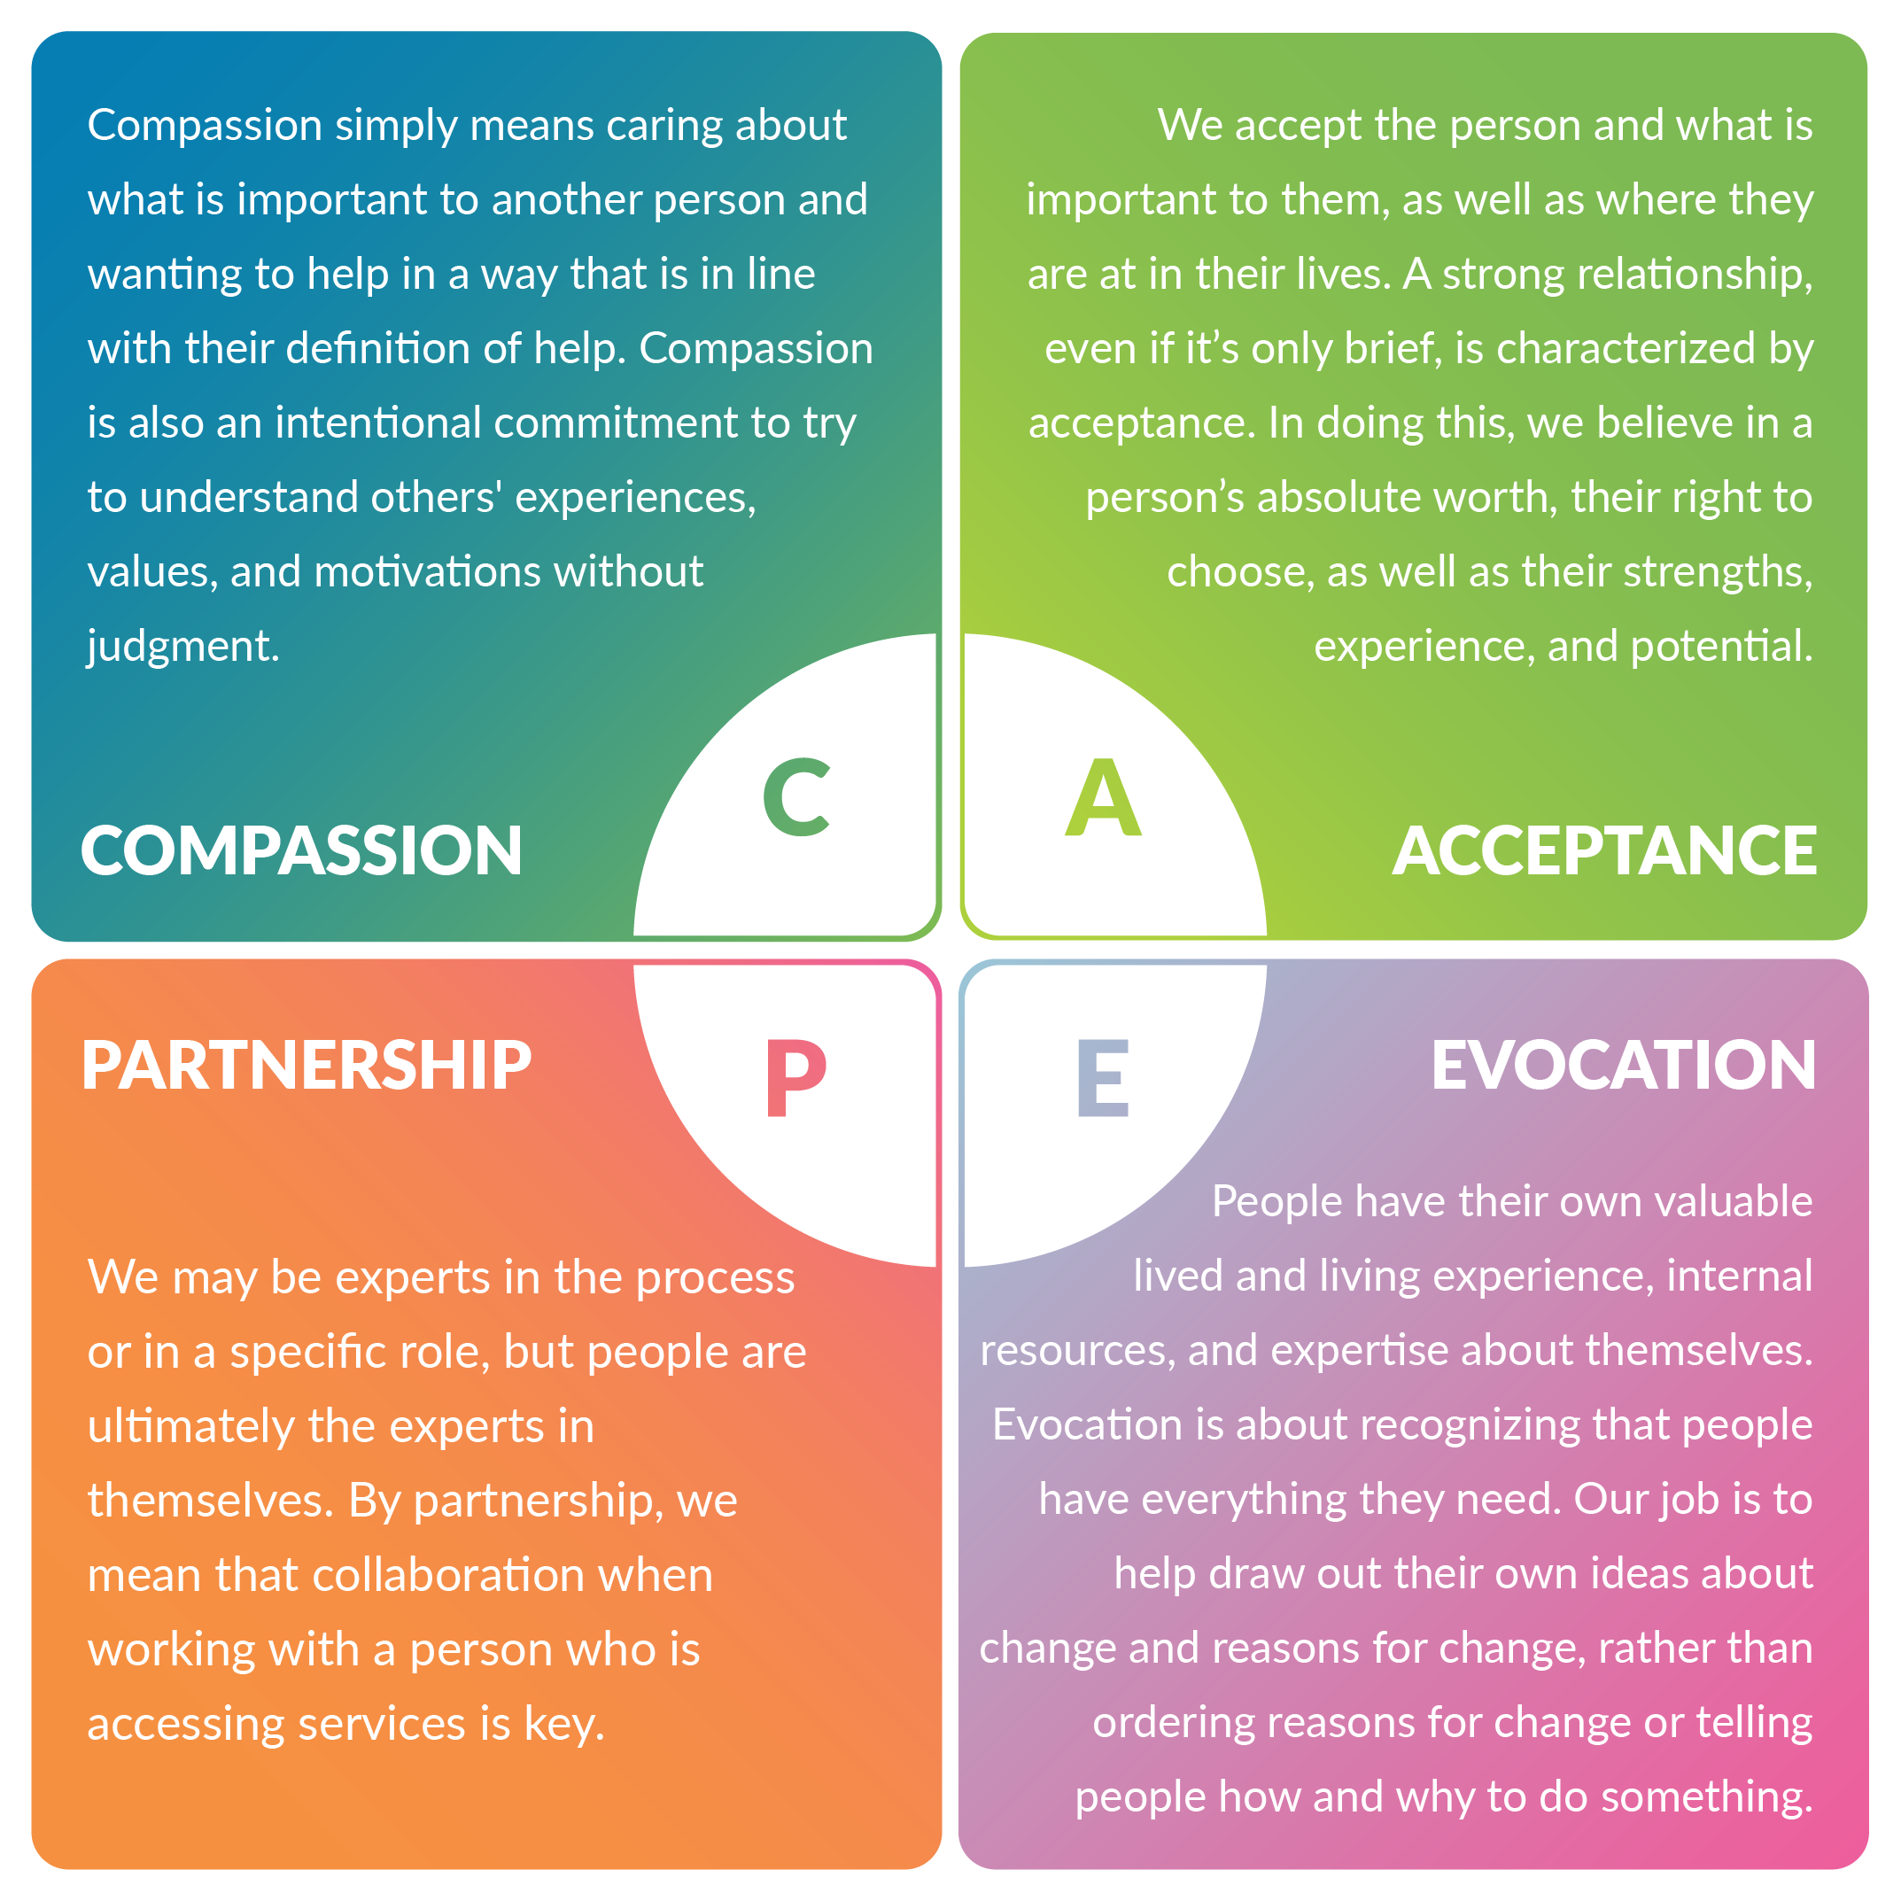
Motivational Interviewing 'CAPE'
Source: Rosengren, D. (2018). Building Motivational Interviewing Skills: A Practitioner Workbook, 2nd Edition. Guilford Press, New York London.
Notes:
The first method is called motivational interviewing. Motivational interviewing is a way of talking with people about change in a way that strengthens the person’s own motivation and commitment to change. The spirit of MI describes how you ‘show up’ in a conversation/interaction. How you say something is as important as what you say. The spirit of MI is in line with the principles of a trauma-informed approach that we’ve talked about today—more specifically, encouraging collaboration, being strengths-based, transparent, non-judgmental, and avoiding triggering language.
You can use the acronym CAPE to remember the spirit of MI—compassion, acceptance, partnership, evocation.
[show graphic on screen and ask participants to read out each component]
Any questions about MI?

Slide 52
"This has been a really difficult decision, but your animal’s well-being is clearly important to you."
Notes:
Brief activity: As a quick activity, let’s see if you can spot which of the following statements are consistent with MI or not.
Statement 1: This been a really difficult decision, but your animal’s well-being is clearly important to you.
Is this consistent with the spirit of MI, yes or no? Why or why not?
[discuss]
Yes, this is consistent. It shows empathy for how the person is feeling, and highlights a strength--that they care about their animal’s well-being.

Slide 53
"I can tell you really care about your dog, so I’m going to let you know that I think he needs to be rehomed. "
Notes:
Statement 2: I can tell you really care about your dog, so I’m going to let you know that I think he needs to be rehomed.
Is this consistent with the spirit of MI, yes or no? Why or why not?
[discuss]
No, this is not consistent with the spirit of MI. The answer acknowledges what is important for the person, but then directs the person as to what to do. It does not invite a conversation with the person to gather their ideas about what they want or whether they have any ideas.

Slide 54
Activity: Practice Applying the Spirit of Motivational Interviewing
Notes:
I think it will be really helpful here to present some real-life scenarios and go through them as a ‘role-playing’ activity to practice MI together. So this scenario is written down in your workbooks but I’ll also present it to you here. And what I'd like to do is put you into breakout rooms, and in those breakout rooms, have one person take on the role of the ‘offender’ and one person act as the animal service worker. And just to try go through a conversation as you imagine it might go. And the animal service worker, keep in mind principles of MI during the conversation. I’ll put them back on screen here. Let’s take about 4-5 minutes to do this.
Scenario: It’s been reported by a social service worker that an elderly woman has many cats in her small apartment. The worker is concerned about both the woman’s and the cats’ welfare. You are directed to visit the woman’s home to assess the situation. When you arrive, you observe about 20 cats in a 300 sq ft space. The cats have discharge around their eyes, and appear to be shy. The woman seems to be having difficulty hearing. How would you approach the conversation, keeping Motivational Interviewing techniques in mind?
[switch slide to CAPE graphic]

Slide 55
Motivational Interviewing/CAPE
Notes:
[discuss]
How did that go? Does anyone want to share some of the approaches they took in their conversations?

Slide 56
The Experience Cube
Notes:
Next we have the experience cube. This is a technique that can be used for giving feedback, and for more difficult conversations.
The CUBE is a tool that helps anyone in any context bring up difficult topics. The Experience Cube, created by Gervase Bushe, is a helpful tool to use in challenging conversations or when giving feedback. We introduce this technique because it is aligned with the trauma-informed principles of being transparent, being non-judgmental, and avoiding triggering language. The CUBE can help us to separate our experience with a situation from our potential biases and judgments about the situation. So this approach helps to remove blame and minimize defensiveness, facilitating a more positive discussion.
A little practice, even with everyday situations will help you to really master this technique quickly. A CUBE response includes four elements: observations, thoughts, feelings, and wants. It doesn’t have to be in a particular order, but all of these are present in a CUBE response.
[show graphic on screen and ask participants to read out each component]
This reminds me of CBT, cognitive behavioural therapy.
We look at the situation (observe), the thought that immediately comes to mind, and then how that thought makes you feel. Then we consider how the feeling affects our behaviour. In CBT, we wish to change the thought – so we can identify another way to look at the situation, change how we feel, and then consider the type of behaviour we might actually want.
So to expand on this conversational approach a little: we're crafting a response to someone in a way that involves all of these elements, so we're including what we're observing about the situation in a non-judgmental way, we're expressing our thoughts on that observation without being assumptive, we're expressing our feelings about that observation (e.g., 'concerned'), and we're describing what the goal is in that interaction.
Does anyone have questions about the CUBE method?
We'll do another activity to practice.

Slide 57
Activity: Practice Using the CUBE Method
Notes:
With this understanding of the CUBE method, I want to give you the opportunity to practice it.
So first, let’s go through two statements, similar to how we did before, and try to determine whether they are consistent with the CUBE method or not. This is activity 5 in your workbook. So let's take a few minutes, read through the statements and make some notes, and then we'll discuss as a group. I'll put the elements of the CUBE back on screen here. [switch slide]
A client comes in with a smaller breed puppy for a first veterinary visit. When you ask about microchipping they ask if it will hurt, then say they aren’t interested.
You inform a client that you have noticed a lump during their cat’s physical exam. You aren’t too worried about it, but they have a very emotional reaction.
We discussed initial impressions, then I asked that they use the experience cube to craft a response.

Slide 58
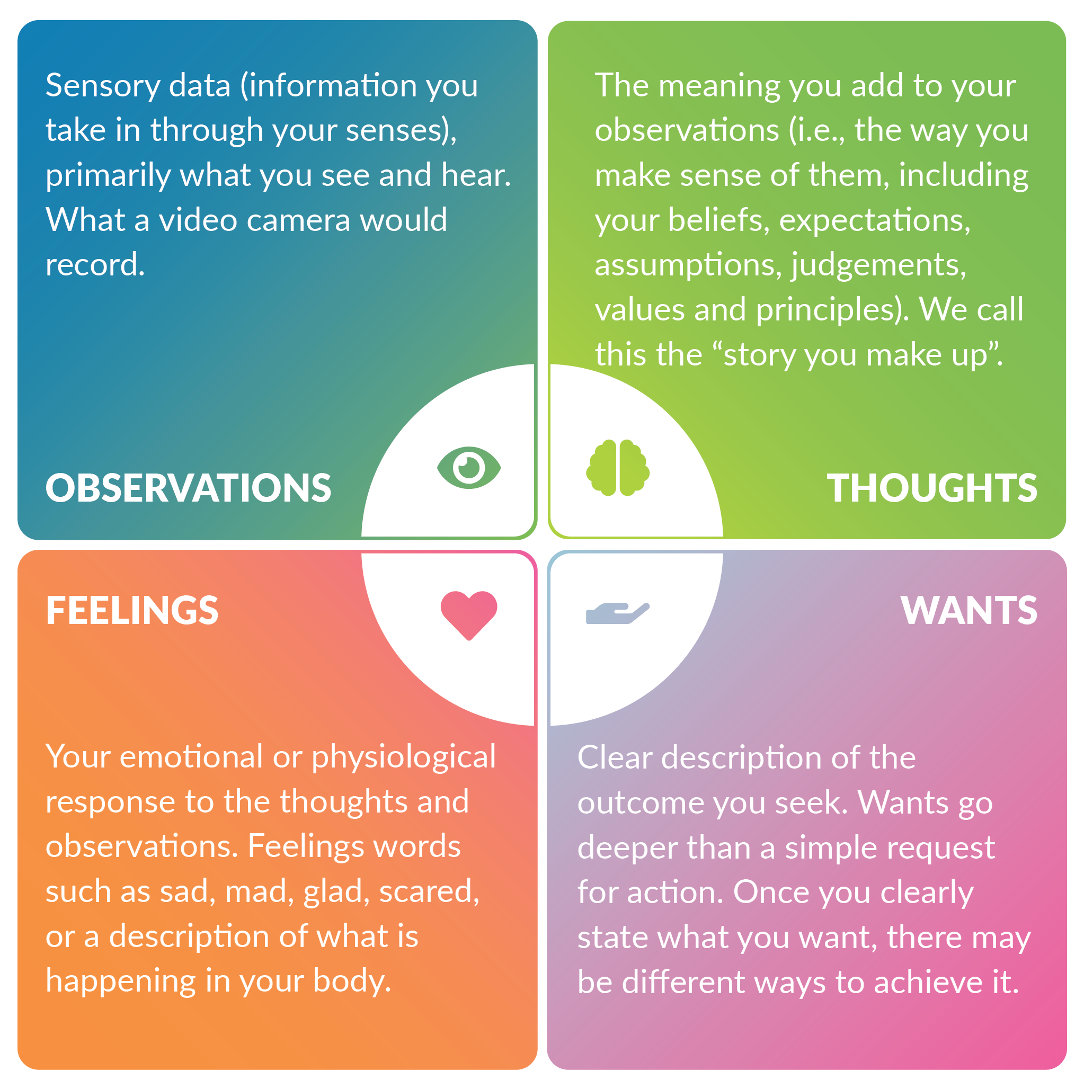
The Experience Cube
Notes:
Statement 1: I see that your dog is out in the yard in the full sun. I don’t see a water dish, and it looks like she is panting a lot. I wonder if you noticed that? I’m a little worried that she might be overheated. I’d like to check her out with you and see if she is okay.
Is this consistent with the CUBE method? Why or why not?
[discuss]
This response is consistent with the CUBE. It includes thoughts, feelings, observations, and wants, and leaves space for the other person to respond.
Statement 2: I’m responding to your call about the stray cat. I need more information.
Is this consistent with the CUBE method? Why or why not?
[discuss]
This response could come across as directive. This response includes observation and wants, but is missing the thoughts and feelings aspects. It also doesn’t invite the other person to respond.
Thanks for sharing everyone!
So now that we’ve had that practice together, I want to practice this method a bit further by doing an activity where you use examples from your own work. In this activity, I invite you to think of two or three different conversations you might encounter in your work, and use the CUBE format to coach yourself through a response. This is activity 6 in your workbook. Let's take about 5 minutes here and then come back together to discuss.
Does anyone want to share?
[discuss]
Thanks everyone for participating!

Slide 59
Reflection
What are the most important things you learned through this experience?
What is one thing you intend to carry back with you?
What is something you commit to doing differently?
Notes:
So we’re almost at the end of this workshop looking at trauma-informed and culturally safe approaches!
As I’ve mentioned, the learning doesn’t end here. A lot of what we’ve covered requires ongoing practice and self-reflection. So let's take a moment now to do one last reflection and think about your key take-aways, and make a commitment or two that will help you apply this back at work. I recommend writing these down to reflect back on later. This is reflection 4 in your workbook. I’ll give you a couple minutes to do this.
What are the most important things you learned in this workshop?
What is one thing you intend to carry back with you?
What is something you commit to doing differently?
Does anyone want to share a takeaway or intention?
[discuss]

Slide 60
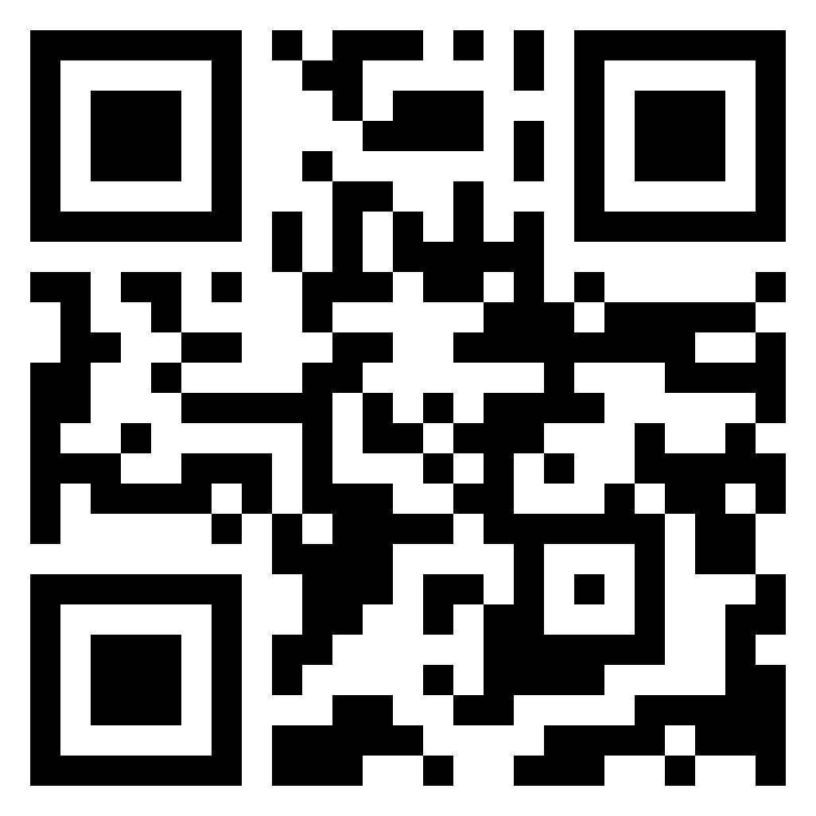
Thank you!
Contact: sareeta@vancouverhumanesociety.bc.ca
Please scan the QR code to share your feedback with us via our short survey.
Notes:
So that's all for today, thank you so much for your time, for sharing your thoughts, and for being vulnerable. And of course, for wanting to make a difference in the lives of animals and humans. I really hope you enjoyed this session, and please feel free to reach out to me if you have any questions or comments at all. [questions if time allows]

