Slide 1
Caring for Yourself & Others: Preventing Compassion Fatigue & Burnout in the Animal Services Sector
Presented by Sareeta Lopez, Program Manager at the Vancouver Humane Society
Notes:
My name is Sareeta Lopez, my pronouns are she/her, and I am the Program Manager for the Trauma-Informed Training Program with VHS.
I’m really excited to be connecting with you all today, so thank you so much for taking the time to join in. In our workshop today we’re going to be talking about compassion fatigue and burnout, and how mitigating these challenges is connected to trauma-informed approaches and achieving resilience.
Things to have: workbook, pens, water, snacks
Feel free to put questions into the chat or write them down as we go, to save for the end.
We'll also be taking a 15 minute break about halfway through, and that will be our only break since this session is shorter, so I’ll indicate when that happens. But please feel free to step away if you need to aside from that.

Slide 2
Land Honouring
I am grateful to currently be living on the unceded territories of the xʷməθkʷəy̓əm (Musqueam), sḵwx̱wú7mesh (Squamish) & sel̓íl̓witulh (Tsleil-Waututh) Nations
We encourage you to learn more about the land you are living on by using the interactive map at https://native-land.ca/
Notes:
I would like to begin by acknowledging that I am grateful to currently be living on the unceded territories of the xʷməθkʷəy̓əm (Musqueam), sḵwx̱wú7mesh (Squamish) & sel̓íl̓witulh (Tsleil-Waututh) Nations.
You can learn more about the land you are living on by using the interactive map at https://native-land.ca/

Slide 3
Learning Objectives
Explain the importance of self care, as well as what compassion fatigue, compassion satisfaction, vicarious trauma, and burnout are.
Identify the signs and symptoms of compassion fatigue and burnout within yourself and others, enabling early recognition and appropriate responses.
Learn effective strategies that allow you to prevent compassion fatigue and burnout, including low impact debriefing and focused empathy.
Implement practical strategies you can implement for self care, considering the physical, psychological, emotional, and cultural impacts your work has on you and your team.
Describe the risk factors and protective factors for vicarious trauma and burnout that are relevant within the animal services sector.
Notes:
The aim of this workshop is that it helps you to become familiar with trauma-informed principles, cultural safety, and ways to promote personal and organizational resilience. This is an opportunity to think about the role you can play in supporting a safe environment for animals, guardians, coworkers, and of course for yourself.
As you know, working to provide services to animals and their people is meaningful and important work. Meaningful work with others, especially in difficult moments, can also be stressful and personally challenging. We tend to look at our work and careers objectively, and think about them in terms of our responsibilities, education, skills, title or pay. We may think less often about the ‘subjective’ part of our work, such as our relationships, how we feel about our work, what inspires us, or what drains us.
In this workshop, we invite you to dive more deeply into understanding how to build trust and safety within your relationships at work, and how to care for yourself in the context of the work that you do in the animal services sector. As we move through this workshop, there will be opportunities for reflection where I’ll prompt you with a question and give you some time to write down your thoughts. There will also be a few activities and opportunities for discussion. You are of course not required to share out loud, but if you feel comfortable doing so, that’s great. The chat box is also available, so please feel free to share there as well when prompted to do so; note that the chat box is public and I will read responses out loud for accessibility.
Trigger warning: This course discusses some difficult topics. Acknowledging loss, trauma, or abuse of any kind is extremely difficult, and it can trigger a range of responses. If you feel triggered, upset, or confused about anything discussed during the training, we encourage you to seek support in a way that feels safe for you. Please feel free to take breaks throughout and do what feels best for you.

Slide 4
What do you hope to learn today?
MENTIMETER GOES HERE
Notes:
Before we get started, I wanted to ask you all to share, if you’re comfortable, what is one thing you are hoping to learn or gain from today’s workshop?

Slide 5
Key Terms
Compassion fatigue (or rather, empathy fatigue)
The emotional exhaustion and reduced compassion that may result from chronically using empathy when helping those who are suffering. It is sometimes referred to as secondary traumatic stress.
Burnout
Occupational burnout results from chronic work-related stress, with symptoms characterized by feelings of energy depletion or exhaustion, increased mental distance from one’s job, feelings of negativism or cynicism related to one’s job, and reduced professional efficacy.
Sources: Berzoff & Kita, 2010; Newell et al., 2016; (Figley, 1995).
Notes:
So, burnout and compassion fatigue. Has anyone heard of these terms before? You can do a thumbs up, or say yes/no in the chat, nod/shake your head.
Let’s start with compassion fatigue.
Workers who provide services to emotionally distressed or traumatized individuals very often empathize with others’ suffering and want to relieve it. This empathy is vital in building trust, but it can also have negative effects over the longer term. One of these effects is compassion fatigue. Hearing about others’ trauma can cause symptoms of compassion fatigue, such as avoiding tasks to reduce exposure to suffering, being on edge, feeling fearful, and viewing the world more negatively. But – recently the research says that compassion actually energizes us – it's empathy that we run out of.
Now what about burnout?
Burnout: Occupational burnout results from chronic work-related stress, with symptoms characterized by feelings of energy depletion or exhaustion, increased mental distance from one’s job, feelings of negativism or cynicism related to one’s job, and reduced professional efficacy (the ability to produce a desired or intended result).
Everyday workplace stressors can also affect a worker’s health and functioning. Such stressors include daily hassles, inadequate staffing levels, deadlines, and a high workload. Repeatedly facing these stressors with limited personal or workplace resources often leads to feeling overwhelmed and experiencing burnout. Some of the main symptoms of burnout are:
emotional and physical exhaustion
cynicism or feeling detached from one’s job
a reduced sense of accomplishment; and
feeling inadequate

Slide 6
How is this related to a trauma-informed, culturally safe approach? Why is this beneficial for both workers and people accessing services?
Sources: BC Provincial Mental Health and Substance Use Planning Council, 2013; Bourassa, 2009
Notes:
So how is the idea of resilience related to a TI/CS approach, and why this is beneficial for both workers and animal guardians/their animals. So why is this important?
The idea is that trauma-informed approaches allow for better outcomes for staff and for people accessing services. And seeing these more positive outcomes allows us to experience more compassion satisfaction, rather than empathy fatigue. As you know, those who work in the animal services sector face high-pressure, stressful situations, sometimes on a daily basis. The unique stressors that those who work in the animal services sector experience can result in burnout, compassion fatigue, and other mental health challenges. Acknowledging this, and having practices in place to minimize and address the occurrence of these effects, is essential to ensure healthy people and a healthy workplace.
It is important for workers to recognize symptoms such as exhaustion, reduced empathy, traumatic stress symptoms, and cynicism, and how these might affect themselves and their relationship with people accessing services. For example, workers might attempt to reduce their trauma symptoms by avoiding people accessing services. These reactions can interfere with a worker’s ability to provide an emotionally safe environment, increasing the risk of the person accessing services being further traumatized and potentially compromising animal safety.

Slide 7
Reflection
What energizes you in your work?
What do you feel you are doing well regarding self-care?
What do you feel you are doing well regarding supporting your coworkers?
What do you find draining or stressful in your work?
How does stress impact your personal wellbeing, your behaviour, relationships, or performance?
Notes:
So before we move on, keeping this information in mind, let’s do a quick reflection activity to think a bit about where we’re at in terms of stress and well-being, related to our work. This is reflection 1 in your workbook. So let’s take 3-4 minutes here to reflect on these questions, and then I’ll bring us back together and see if anyone would like to share.
What energizes you in your work?
What do you feel you are doing well in regard to self-care?
What do you feel you are doing well in regard to supporting your coworkers?
What do you find draining or stressful in your work?
How does stress impact your personal wellbeing, your behaviour, relationships, or performance?
Try to be honest with yourself here. It's easy to feel pressure, especially as marginalized folks, to feel we can't admit that anything drains us or feels stressful at work. It's work, we have to do it. But you must care for yourself, and to do that, you must be honest.
[offer chance to share about any of these; no pressure]
For example, for myself, I feel energized when I get positive feedback and see the direct impact that my work has. In regard to self-care, I feel that I am good at identifying when I need to give myself a break, mainly by checking in with my body and where I'm feeling any tension or stress. I'm also becoming more aware of what makes me feel better in those moments. But I feel like I need to do better at not feeling guilty for taking that time, and feeling like I should be doing something “productive” because really rest is productive, and human. Rest is not valuable only because it can lead to production, but that's a conversation for another day! Stress results in me not eating well, sleeping well, I might be more quick to be irritated, more impatient. I start deprioritizing my relationships, and becoming scatter brained. Ultimately, my behaviour doesn't match my values.

Slide 8
Professional Quality of Life: Compassion Satisfaction & Compassion Fatigue
Notes:
As you know, working in the animal services sector means that workers are often subject to seeing and hearing about both human and animal traumas. Understanding the positive and negative aspects of working in a service-based system, or directly working with those who experience trauma and suffering, can improve our ability to help them and our ability to keep ourselves healthy and safe in our work.
Professional quality of life is the quality and satisfaction a person feels about their work. Both the positive and negative aspects of our work make a difference to our professional quality of life. This may apply whether or not someone works directly with animals or their guardians, or works in supportive or leadership roles.
Compassion satisfaction and compassion fatigue are two aspects of professional quality of life.
In our context, they encompass the positive (compassion satisfaction) and the negative (compassion fatigue) parts of helping animals or people who have experienced suffering. Compassion satisfaction is the pleasure and meaning one gets from supporting animals and their guardians. Compassion fatigue is the toll that caring or supporting takes on you. Just as it sounds, compassion fatigue is the exhaustion and sense of emptiness that can come about in helping roles.
During the research for this project, one of the topics we explored is how workers in the animal services sector are affected by compassion fatigue and burnout. To do this, we interviewed 11 animal service workers who have experience with the surrender and/or seizure of animals.
Compassion fatigue was an experience that nearly all of the participants resonated with. I want to share a few quotes that detail participants’ feelings about compassion fatigue in the animal services field.

Slide 9
Notes:
[read aloud]
Researcher: Have you heard of compassion fatigue?
Participant: Oh yeah.
R: Is that something you feel like you've experienced with your work?
P: For sure, you always worry about the animals right? 24/7, LIke I see enough. I see it repeats on the news. It repeats on social media. I just want to turn it off. A lot of my fatigue comes from that, because I deal with a lot of things on my own like when I do see a seizure or whatever, you know for five days I cry.

Slide 10
Researcher: “…Is there anything in place right now, any policies or anything in place right now? So if someone was feeling burnt out or having compassion fatigue and they dealt with something particularly difficult at work. Are they able to take a mental health day or…does any direction about that come from leadership? Or is that a place that has room for improvement?” Participant: “Yeah, there's definitely room for improvement for sure. Not to my knowledge. I don’t think we could just take a mental health day or a lieu day, I think we would have to take a sick day and whether or not we disclosed what it was about obviously is up to us...and I wouldn’t really say leadership really makes that obvious or makes it known or really provides other alternatives, maybe because they’re also still trying to figure it out. I’m not quite sure.”
Notes:
Mental health in general was a topic that many participants who worked in the animal services field noted as an area in need of attention, specifically noting the pressure to minimize or hide any mental health concerns.
[read aloud]
Researcher: “…Is there anything in place right now, any policies or anything in place right now? So if someone was feeling burnt out or having compassion fatigue and they dealt with something particularly difficult at work. Are they able to take a mental health day or…does any direction about that come from leadership? Or is that a place that has room for improvement?” Participant: “Yeah, there's definitely room for improvement for sure. Not to my knowledge. I don’t think we could just take a mental health day or a lieu day, I think we would have to take a sick day and whether or not we disclosed what it was about obviously is up to us...and I wouldn’t really say leadership really makes that obvious or makes it known or really provides other alternatives, maybe because they’re also still trying to figure it out. I’m not quite sure.”

Slide 11
“I think it’s important to talk about... I think we hide how bad our mental health is in the organization.”
Notes:
[read aloud]
So take a moment to sit with this. [deep breath]
Check in with your body. Is there tension? Where? Deep breath, send love to that part of your body, exhale to release.
It is very possible that you relate to some of these lived experiences. Maybe think about if you feel you've experienced compassion fatigue, or compassion satisfaction? Perhaps you've experienced both. Does one outweigh the other? Do you feel that it would be helpful to know how to cope with these experiences?

Slide 12
Experiences of Vicarious Trauma, Burnout, & Compassion Fatigue
Notes:
Compassion fatigue further breaks down into two parts: vicarious trauma, and burnout or emotional exhaustion.
Trauma in the workplace may be direct (primary) trauma, indirect trauma, or a combination of both. Indirect exposure to difficult, disturbing and/or traumatic images and stories of the suffering of others (animals and humans) can impact us as individuals and as professionals.
When working alongside others' suffering changes us so deeply in negative ways that it alters our view of the world, this is vicarious traumatization (VT). However, learning from, and understanding, vicarious trauma can allow us to better cope with it.
Secondary traumatic stress is a negative feeling that mimics post-traumatic stress disorder; it is caused by hearing about or working with others' direct trauma.
I’m going to share a quick video that discusses how employees in the animal services sector have been impacted by stress and trauma.

Slide 13
How Animal Services Workers Have Been Impacted
Notes:
Video: https://www.youtube.com/watch?v=fGQGZjpJnDg
Transcript:
Many aspects of animal services work can cause stress and trauma and result in negative emotions and impacts to mental health. Animal services workers who participated in our project described the uncertain nature of their work, and the difficulty of upholding empathy when continuously seeing neglected animals:
One participant shared:
“…that’s what I think is the hardest thing for us because…we're not going to lose our empathy for animals, animals are why we do what we do, animals are not held to blame…. It is people that we lose empathy for. And I think that can become a problem especially if you're dealing with people who already have trauma.... I think we've all had trauma, right? But if we've lost our empathy for people, I don't think that's useful. The hardest thing for animal welfare work is losing your empathy for people”
In reference to their first few years working in the animal services sector, another participant shared the following:
“…it’s been a rollercoaster really. From all good to a lot of bad experiences too. A lot of things I didn’t anticipate affecting me in the ways they did. I’m a very soft-hearted person to a degree but when it came to work with animals…I felt like I had already seen a lot…of pain and suffering on the human side as well as animal side, but that didn’t really prepare me for what happened [in this role]”
Now, I also want to share one more short video, that outlines the experiences of burnout that workers in the animal service sectors shared with us in their interviews.

Slide 14
Experiences of Burnout in the Animal Services Sector
Notes:
Video: https://www.youtube.com/watch?v=waTVGYLqwD0
As mentioned in the video, secondary trauma can occur if burnout and compassion fatigue go unaddressed. Dr. Steven Silver describes secondary trauma as occurring “when an individual who suffered a severe stressor next encounters what was expected to be a supportive and protective environment and discovers only more trauma.” So how we support others in processing traumatic or stressful events is really important.
Transcript:
The experience of burnout is extremely common within workers in the animal services sector. Many participants in our project discussed their experience with burnout. The following participant quotes demonstrate workers’ experiences of burnout and how it affected them.
“…there were definitely moments where I felt like I don't want to go back. I don’t want to continue doing it. And again I think if I ever stop working with [workplace] then that will be the reason.”
“…it’s a high workload, we’re constantly getting requests for surrenders, assistance for owned animal treatments, strays, calls about people just needing public veterinary services… veterinary services are very expensive and not necessarily accessible for most people.”
“I've seen burnout for us and it is scary. You know, we lost everybody…like all the volunteers [due to burnout]”
“…dealing with the cases that we deal with and just the volume of work in general definitely has led to a bit of burnout”
It is possible that you resonate with the experiences of these workers.
The impacts of burnout on both people and organizations are evident. If left unaddressed, a low professional quality of life can result in high staff turnover and lead to negative outcomes for animals and guardians, or even cause secondary trauma.

Slide 15
Signs, Risk Factors, & Protective Factors
Notes:
Let’s take a few moments now to consider the risk factors and the signs of vicarious trauma, as well as the protective factors (i.e. the skills, strengths, resources, supports or coping strategies that one can use to deal more effectively with stressful events).
[read graphic aloud]

Slide 16
Reflection
Can you think of any other potentials signs of vicarious trauma, risk factors, and protective factors?
What do you notice about yourself regarding the risk, protective factors and signs of vicarious trauma?
What resources and supports do you have available to you to help protect you?
Notes:
Now let's take a moment to reflect on how you are doing with regard to these factors.
What do you notice about yourself with regard to the risk, protective factors and signs of vicarious trauma?
What resources and supports do you have available to you to help protect you?
This is reflection 2 in your workbook. Because this one is a bit more of a personal reflection, we don't need to share with the group, unless you'd like to. Let’s take a couple minutes and then I’ll bring us back together.

Slide 17
Self-Care
Self-care consists of activities we do on a regular basis to look after our mental, emotional, spiritual, and physical health. Self-care ideally includes activities that we practice regularly, and that look after the physical, psychological, spiritual, emotional, social, and vocational selves. These activities are different for everyone, and wellness practices vary across cultures and may emphasize different foods, activities, or prayer.
Notes:
Ok, so let's talk a bit about self-care. You've likely heard of this term before! Self-care consists of activities we do on a regular basis to look after our mental, emotional, spiritual, and physical health. Self-care ideally includes activities that we practice regularly, and that look after the physical, psychological, spiritual, emotional, social, and vocational selves. Vocation also doesn't need to mean occupation, it could be a religious calling, or simply an interest in a particular type of work outside of your career. It's so important to ensure that you have a life outside of work, even if you do love your job.
These activities are different for everyone, and wellness practices vary across cultures and may emphasize different foods, activities, or prayer.
Does anyone want to share in the chat box some examples of what you do for self-care?
[discuss]
Here are a few more examples:
stretching
journalling
reading
listening to/playing music
special teas or drinks
meal prep
acupuncture
walking in nature
going to a place of worship
smudging
prayer or meditation
power naps
saunas or baths
lighting candles
caring for plants
reading
art
photography
sports
spending time with loved ones, including pets
The importance of self-care is that when we carve out time to take care of ourselves, we are better equipped to take care of others.

Slide 18
Reflection
Think about your own self-care practices, and reflect on the following questions:
On a scale of 1-5, with 5 being really strong, how satisfied are you with your self-care?
What makes you feel your best?
What else could you do that might help you to heal or recharge?
Notes:
Please take a moment to think about your own self-care practices, and reflect on the following questions: You don’t need to share out loud; but I encourage you to write down a few things in your workbook. This is reflection 3 in your workbook, and let's take 3-4 minutes for this.
On a scale of 1-5, with 5 being really strong, how satisfied are you with your self-care?
What makes you feel your best?
What else could you do that might help you to heal or recharge?

Slide 19
Break Time!
Notes:
Break – 10-15 minutes

Slide 20
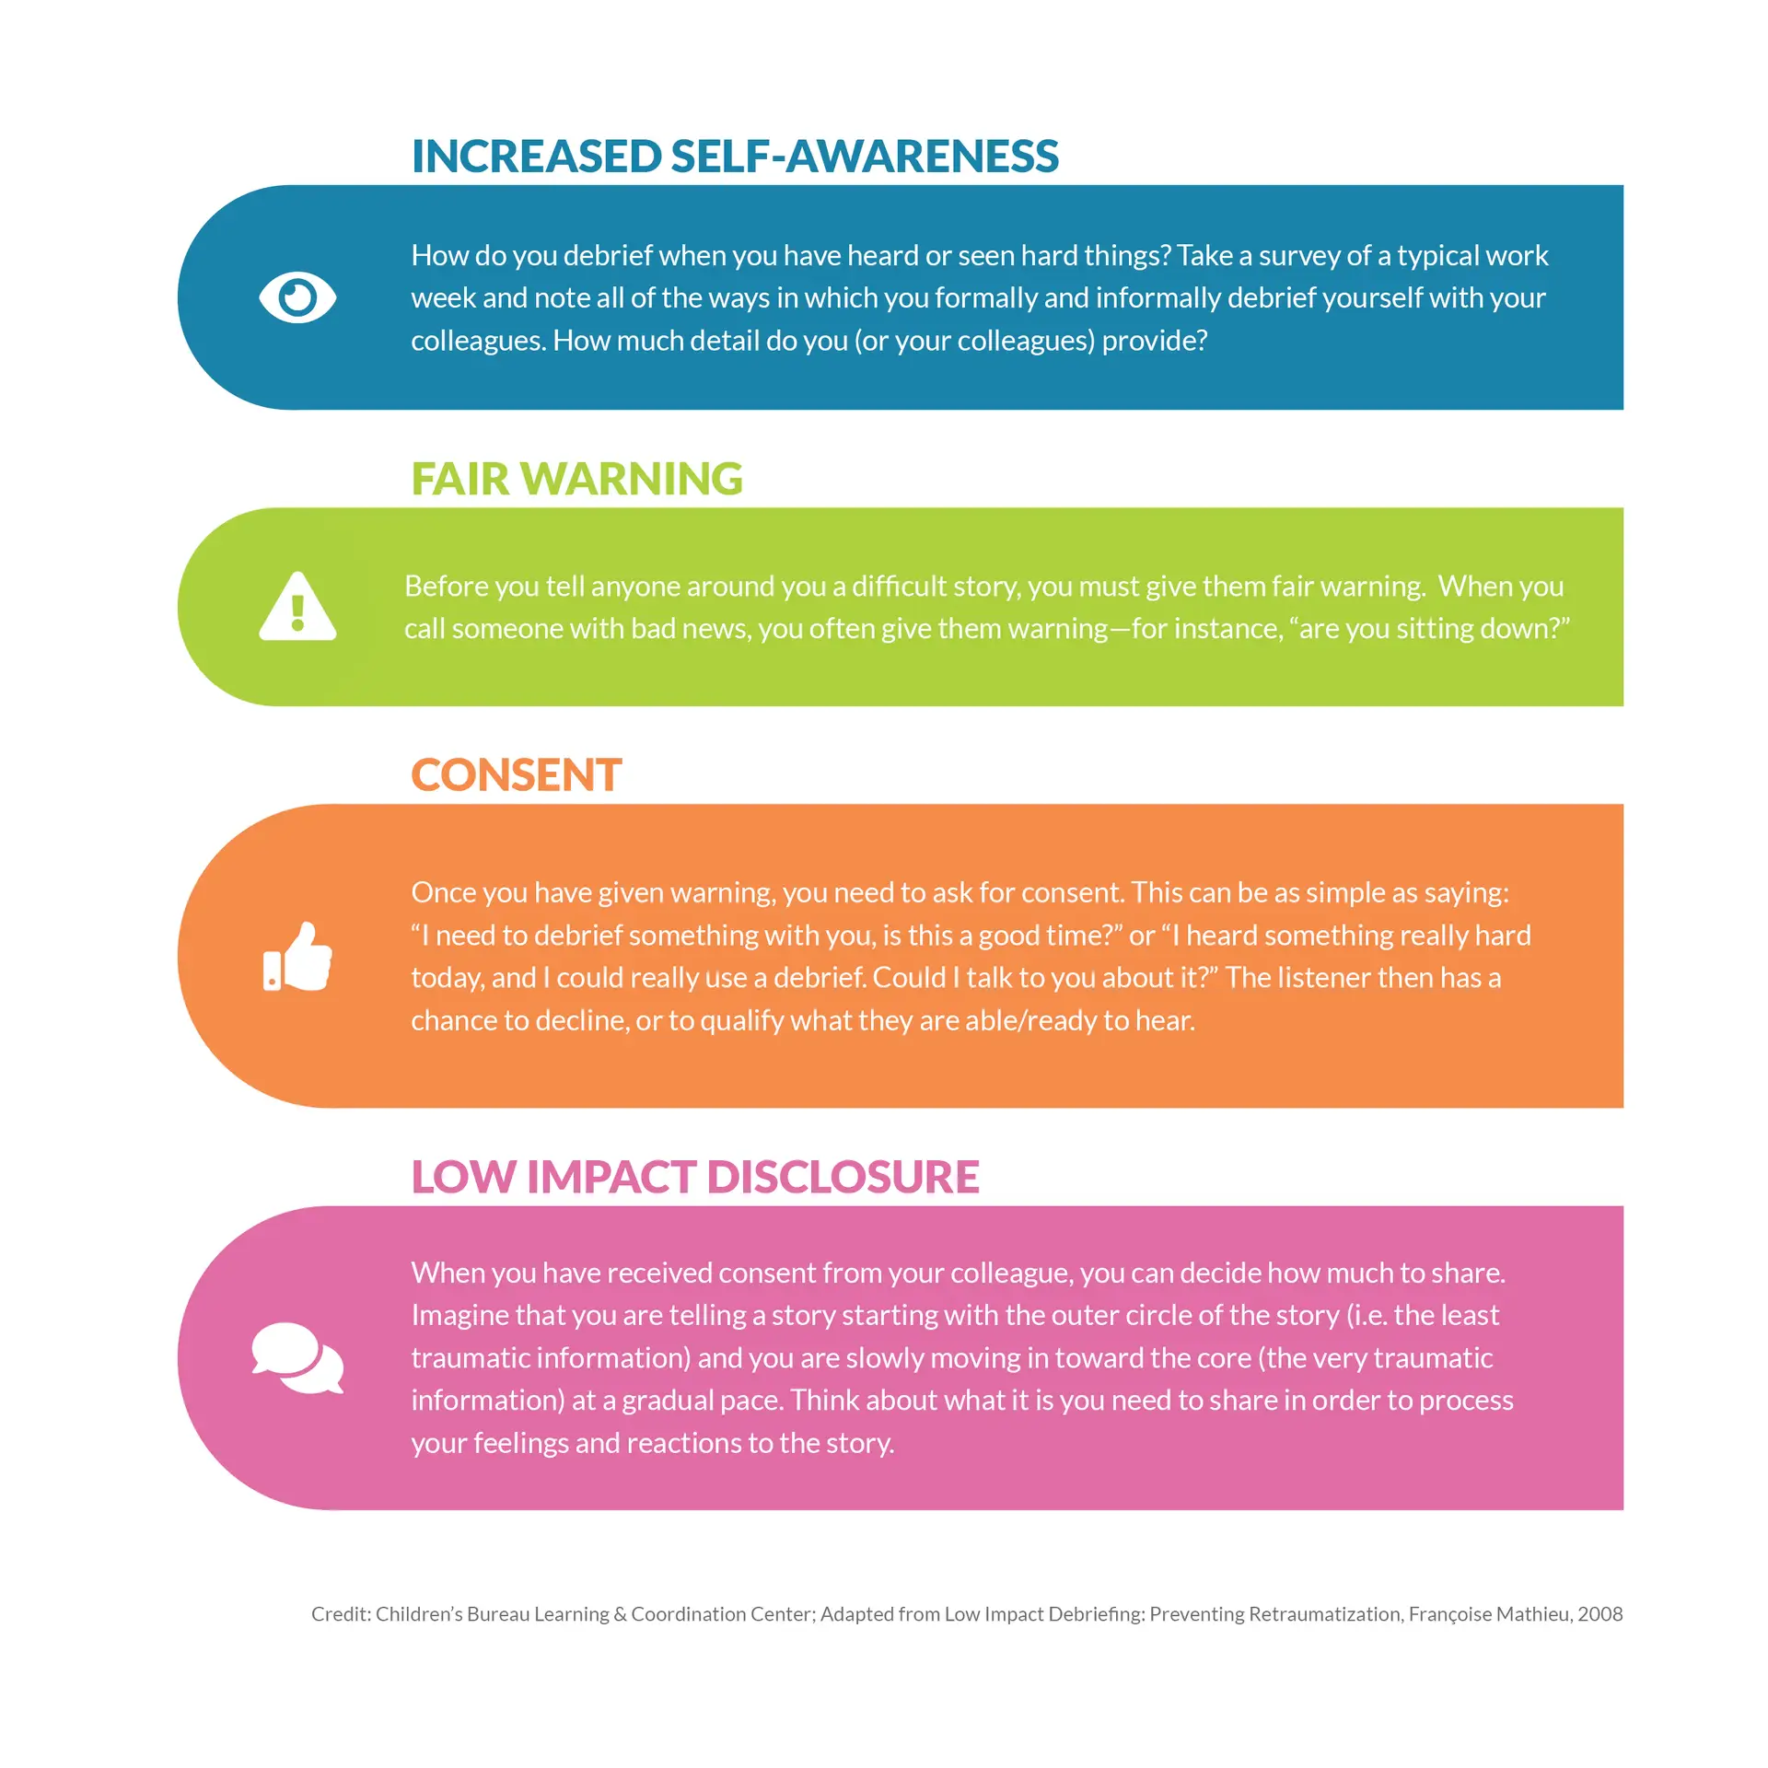
Connection & Low-Impact Debriefing
Notes:
While we talk about what we can do to look after ourselves, it's also important to mention that healthy, trauma-informed environments are also safe places where we look after each other too.
In fact, disconnection from others is often a result of trauma. Making an effort to stay connected with colleagues, asking people how they are (not just to be polite) and taking time to listen are simple ways to build meaningful connections with the people around us. It's these types of social connections that help us most to remain resilient and buffer ourselves against the effects of adversity, stress, and trauma.
One way we can maintain connection is through debriefing, which is a great practice to support staff mental health. Debriefing is an important aspect of coping with vicarious trauma.
However, it is also important to note that we should first check in with the person we're hoping to debrief with, to make sure they have the capacity to support us in that moment. What we share in a debrief can also have an impact on the person listening. One way to mitigate this is to engage in Low Impact Debriefing, which is a strategy created by Francoise Mathieu. This is a 4-step process that involves the following:
[show graphic and have participants take turns reading out loud]
Great, thank you for reading. I want to mention that it's also important to remember that when someone comes to share information or debrief with you, you can also practice setting boundaries when you don’t feel that you have the capacity to be supportive in that moment, and that that's okay.

Slide 21
Activity: Debriefing
Notes:
In pairs, give folks 15=20 minutes to take turns debriefing about something for 5-10 minutes each.

Slide 22
Focused Empathy
Notes:
Ok, so let's move on to talk a bit about empathy. As the nature of your work involves caring for animals and other people, you likely practice empathy on a regular basis. As we talked about earlier, empathy is critical to working well with others.
But empathy can also be draining, and we don’t have an unlimited supply to draw upon. For example, if your empathy gets used up earlier in your work day, you may have less to give later or at home. To protect this valuable resource, it’s important to be able to use it in a focused way, and practice your ability to turn it off sometimes. So how can we practice turning off empathy?
[show graphic and have participants take turns reading out loud]
These may seem like small things, but I have personally found that having these little rituals and practices to draw on, especially when I’ve had a particularly hard day, has been really useful.

Slide 23
Safety Plans & the Stress Response Cycle
A safety plan can provide us with a ready-made option for responding in stressful situations, so we don’t have to think too much about it when we’re in a situation.
“The good news is that stress is not the problem. It’s how we deal with stress—not what causes it—that releases the stress, completes the cycle, and ultimately, keeps us from burning out. You can’t control every external stressor that comes your way."
Notes:
So the last few things I want to share about today go hand in hand, and those are safety plans and the stress response cycle.
Have you ever said something you wish you wouldn't have, and perhaps later on you felt regret that you struggled to shake away? Have you felt your anxiety or stress was in control of you?
In animal and human services work, you likely encounter stressful events or situations regularly. Most of the time, you are probably able to manage and tolerate the stress.
But when stress builds up, just like with fear thresholds in animals, we may find ourselves at a disadvantage. A safety plan can provide us with a ready-made option for responding in stressful situations, so we don’t have to think too much about it when we’re in a situation.
When we face a threat, our bodies and brains have a natural response system. Like all biological processes, a stress response has a beginning, a middle, and an end. We call it the Alarm stage, Resistance stage, and the Exhaustion stage.
In Alarm, our amygdala sends signals to hypothalamus, which activates the sympathetic nervous system and results in fast breathing, a rapid heartbeat, energy surge, and increased alertnness. This is the fight/flight/freeze response.
Resistance, which happens once the sense of threat or danger has passed. Notice that we say "the sense of" threat. It doesn't necessarily indicate that there is a threat! Your body activates when it thinks there is a threat. So when the threat seems like it's passed, your body puts the brakes on starts reducing your stress response. If not, you'll experience difficulty concentrating, irritability, and frustration.
Exhaustion happens if you can't complete the stress cycle.
If we can move all the way through the stress response cycle, we stay healthier. If we don’t complete the process, and we stay stuck in a stress cycle, that is when stress can become destructive for us. Drs. Amelia and Emily Nagoski identify the difference between stress and stressors in their book, "Burnout: The Secret to Unlocking the Stress Cycle." They write:
“The good news is that stress is not the problem. It’s how we deal with stress—not what causes it—that releases the stress, completes the cycle, and ultimately, keeps us from burning out. You can’t control every external stressor that comes your way. The goal isn’t to live in a state of perpetual balance and peace and calm; the goal is to move through stress to calm, so that you’re ready for the next stressor, and to move from effort to rest and back again.”
According to the Nagoskis, the six best ways to complete the stress response are:
laughing
doing something creative (not limited to arts)
finding comfort: cozying up with a weighted blanket or physical affection with someone safe and appropriate or a pet
crying
deep breathing
physical activity/movement
This is obviously not an exhaustive list—there are many other ways to complete the stress response. Some other strategies we can draw on to reduce our stress include practicing meditation and other mindfulness techniques, writing down our thoughts, talking with others, or engaging in a physical activity that is calming and accessible for you. Engaging in these activities will hopefully help you to complete the stress cycle and move on from it.
Now, safety plans are meant to be used in the moment, when we’re having a reaction to something. By thinking about these situations and reactions beforehand and creating a safety plan for them, we can be better prepared and can feel good about how we respond under stress.
Creating safety plans can help us to self-manage our emotional reactions. Some of us might want to keep our safety plan handy (near our ID badge, or in a wallet) so we can use it right in the moment when we can't readily access our more reasonable mind.

Slide 24
Activity: Creating a Safety Plan
Notes:
Using a safety plan can also help us complete the stress response, which is an important part of processing stress so that we don’t get stuck in a stress response and cycle.
We have created a worksheet to help you think about and create your own safety plan.
This is the activity in your workbook called 'creating a safety plan'. Let’s take about 10 minutes to do this, and try to draw on some of the things we've talked about today.
As a trigger warning, the worksheet invites you to think about potentially triggering situations, as well as negative feelings. Safety Plans are often used as a way to help folks who experience suicidal thoughts and self-harm, and in this case we are more focusing on a plan that you can use to calm your body and end the stress cycle. However if you do experience suicidal thoughts or self-harm, I recommend speaking to a therapist and building a safety plan for that as well.

Slide 25
Reflection
What are the most important things you learned in this workshop?
What is working well for you that you want to continue doing?
What is one thing you intend to carry back with you?
What changes might you think about making to support yourself, your people you serve, or your colleagues in managing stress?
What is something you commit to doing differently?
Notes:
Okay, so we have almost reached the end of this workshop! Everything that we’ve covered today requires ongoing exploration, practice and self-reflection, so as a final reflection, please take a moment now to think about your key takeaways, and make a commitment or two that will help you apply these in the workplace. This is reflection 4 in your workbook, and we'll take about 3-4 minutes here.
What are the most important things you learned in this section?
What is working well for you that you want to continue doing?
What is one thing you intend to carry back with you?
What changes might you think about making to support yourself, your people you serve, or your colleagues in managing stress?
What is something you commit to doing differently?

Slide 26
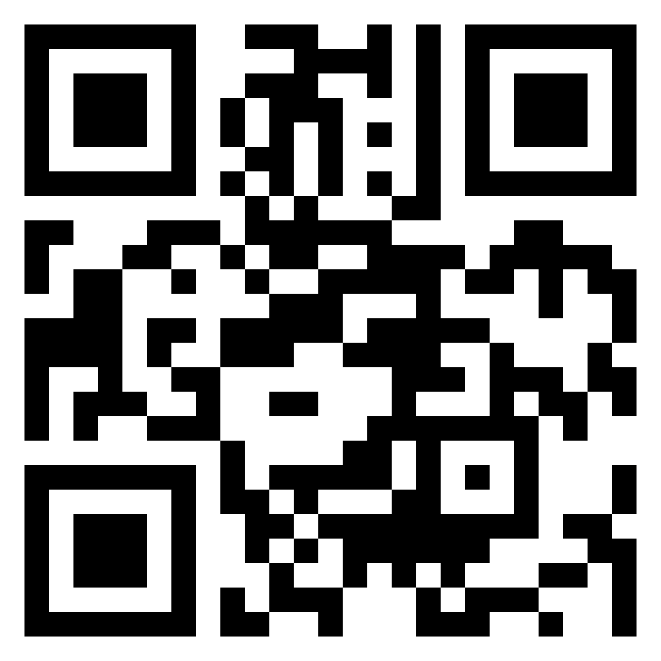
Thank you!
Contact: sareeta@vancouverhumanesociety.bc.ca
Please scan the QR code to share your feedback with us via our short survey.
26
Notes:
I want to wrap up by acknowledging that our workplace environments are dynamic and complex, and we're an integral part of the animal services system. No matter what our role is, we all share the responsibility for creating and maintaining healthy teams and environments, and I really believe that trauma-informed approaches can help facilitate this. Leaders, in particular, have the unique opportunity to help initiate and create higher-level change in the organizations and systems they are a part of. And I know that responsibility can sound daunting
Thank you so much for your time, for sharing your thoughts, and for being vulnerable. I really hope you enjoyed this session, and please feel free to reach out to me if you have any questions or comments at all.
Take 10 min for survey – might need to turn phone horizontal to see all the options in the disagree/agree questions!

